Slide 1
Resources and notes
© 2026 mamood ahmad | ma@tadf.co.uk | tadf.co.uk | Mamood Ahmad | LinkedIn
Permission granted to share and use unmodified with attribution (any or all slides and images). This includes use of material for training others / students.
  Images © 2025 by Mamood Ahmad licensed under CC BY-ND 4.0. To view a copy of this license, visit https://creativecommons.org/licenses/by-nd/4.0/
  Please include license on all images
Access the Train-the-Trainer On-Demand Learning Plan
Access to resources, images, slides, and video lessons and for tutoring: https://www.tadf.co.uk under “Whole solution resources” or elearning https://www.tadf.uk/courses/newintro
  Document Embedding Context, Diversity and EDI into training [ NOW Available ] : Guidance for provision, design and delivery of training now available
Book with 20% OFF: A New Introduction to Counselling and Psychotherapy [ Routledge ]
For support, CPD requests, feedback, different formats or adaptations email (including for CPD, speaking and curriculum change consultancy) newintro@tadf.co.uk
Linkedin:

Slide 2
Please Advocate
If you are using the solution, please email newintro@tadf.co.uk to let us know as it help gauge take up and build community. Also, feedback or requests for change are welcome.
Please let others especially training providers, tutors, and supervisors know about the solution to a whole embedded approach to curriculum and practice (as required by SCoPEd)
Please post on social media and share with contacts in organisations and standards bodies
Tutors consider adding resources and book on reading lists.
  Not only does this advocate but it also helps sustain years of free labour that has gone into the work.

Slide 3
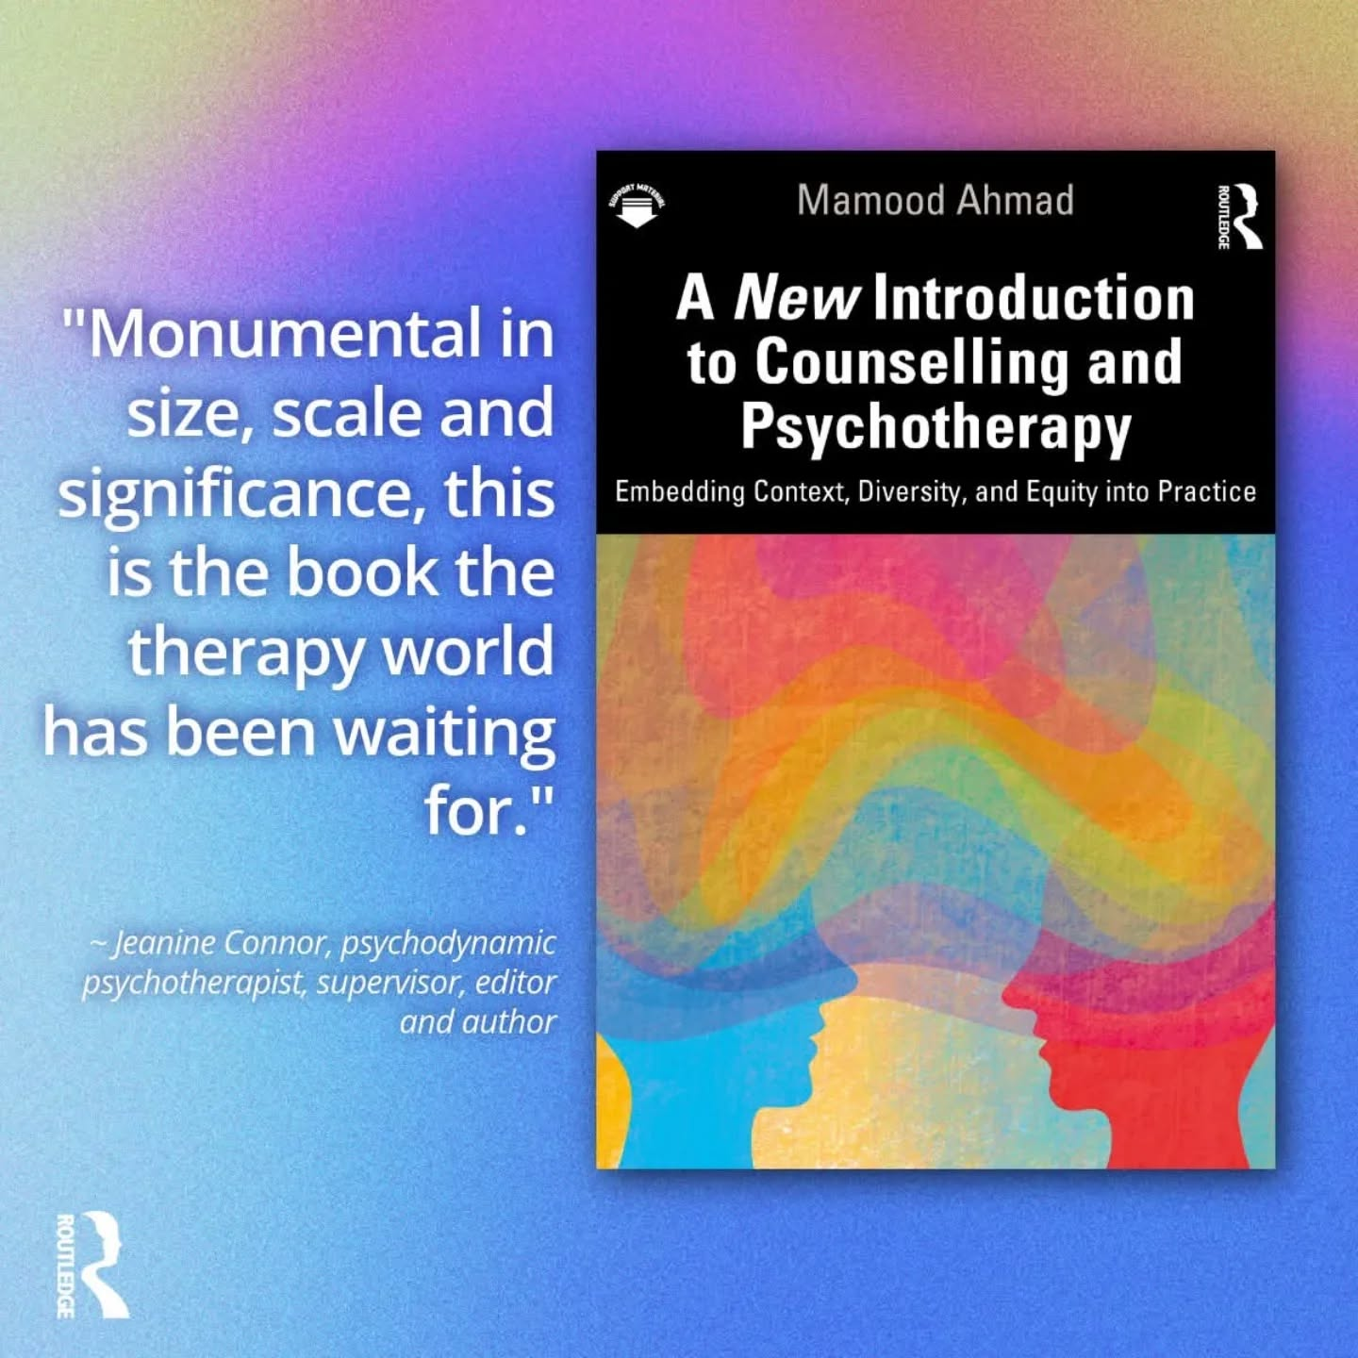
WHOLE EMBEDDED CURRICULUM IN A BOOK
20% off codes go to tadf.co.uk/newintro/

Slide 4

WELCOME
How to Embed Context, Diversity, and EDI in Relationship 2.0 Curriculum & Practice
Mamood Ahmad
#TADF
tadf.co.uk
Linkedin: Mamood Ahmad | LinkedIn
FREE Access to all resources, images, video lessons, community & slides: https://www.tadf.uk/courses/newintro
For curriculum support, CPD, speaking and tutoring requests
email: newintro@tadf.co.uk

Slide 5

The Wholeness Solution
In 5-Easy Steps
Social change
World and planet health
The Wholeness Solution
Collective growth & repair
Professional culture
Access/ibility
Professional
health
Compliance (SCoPED)
Notes:
Plant seeds that flourish

Slide 6
Agenda
Rationale and aims
1 or 5-Step solution
What can WE DO?
ADD
LOGO HERE

Slide 7
WHOLE EMBEDDED CURRICULUM IN A BOOK
+ ONLINE RESOURCES & LESSONS
20% off codes go to tadf.co.uk/newintro/

Slide 8

Current Landscape (As-is)
Cultural (MCC) / MSJCC
Social and personal context
Intersectionality
Mind-Body: Stress, trauma, harm
Normativity, difference and diversity
Worldviews including R/S
Knowledge and by experience
Communication & linguistics
Relationship and sexuality
Access/ibility & EDI (Inc. Organisational & Service)
People A
B
A
R
R
I
ER
People B
PRIMARY KNOWLEDGE & PRACTICES
(3-Schools)
Add-ons
SECONDARY KNOWLEDGE & PRACTICES
subjects
Subjects
Excluded
Context,
Knowledge,
Lived experience
Decontextualised and centralised knowledge replicates to subjects, professional structures and client practice
Contextualised and decentred knowledge. Separation replicates to subjects, professional structures and client practice
Therapy Knowledge Landscape © 2025 by Mamood Ahmad is licensed under CC BY-ND 4.0.
To view a copy of this license, visit https://creativecommons.org/licenses/by-nd/4.0/.
A New Introduction to Counselling and Psychotherapy [ Routledge books]
Notes:
Social class is seen as secondary and invisible in this scheme, poverty, neighbour hood and social determinants, and economic status.

Slide 9
Whole Embedded Architecture: An Augmented Baseline for Helping
Iterations 1..n
The Wholeness Solution
Time
Standard Helping
Baseline
Secondary/contextual
Primary
Modality, helping profession & Subjects

Slide 10
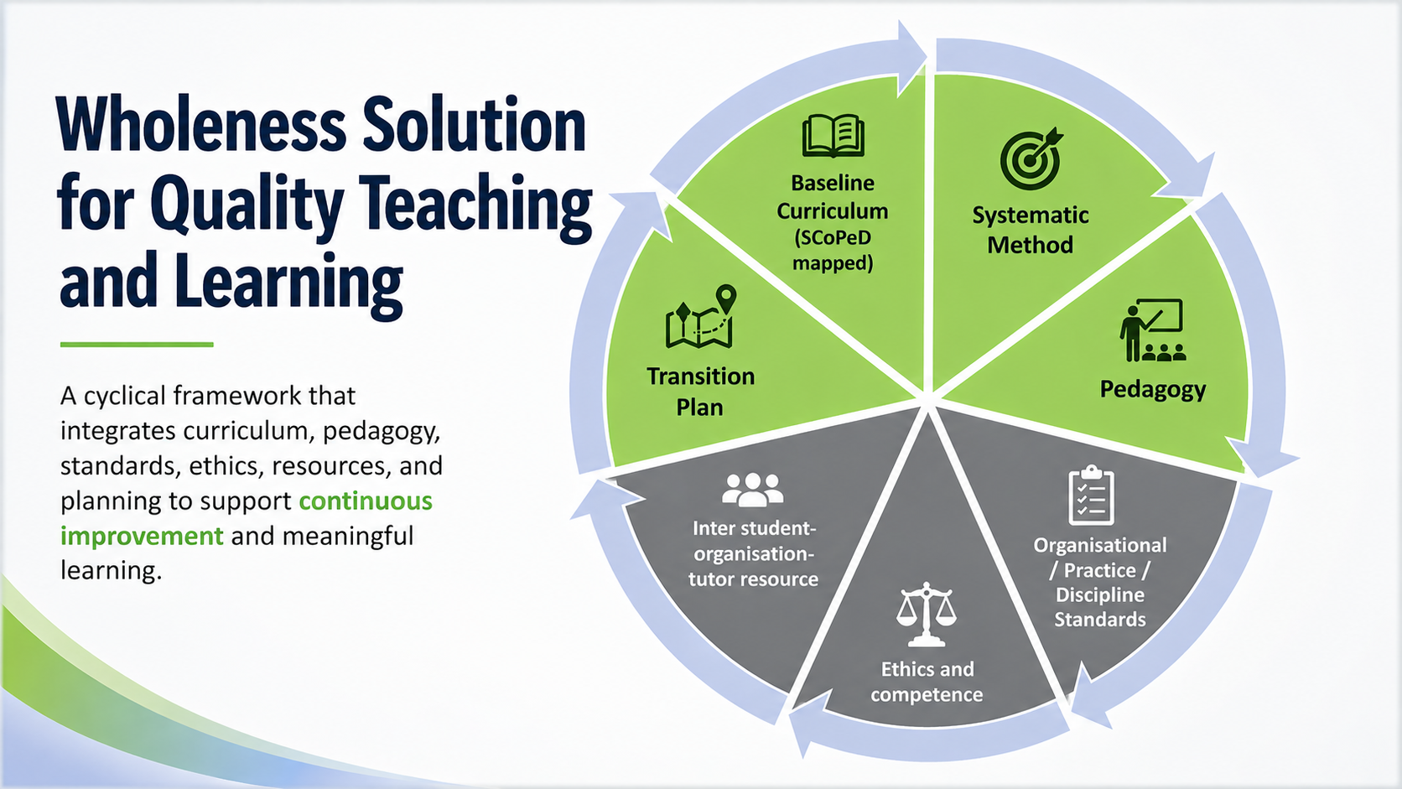
The Wholeness solution
Systematic
Method
Pedagogy
Transition Plan
Organisational/ Practice / Discipline Standards
Ethics and competence
Inter student-organisation-tutor resource
Baseline Curriculum (SCoPeD mapped)
Framework
& Advocacy

Slide 11
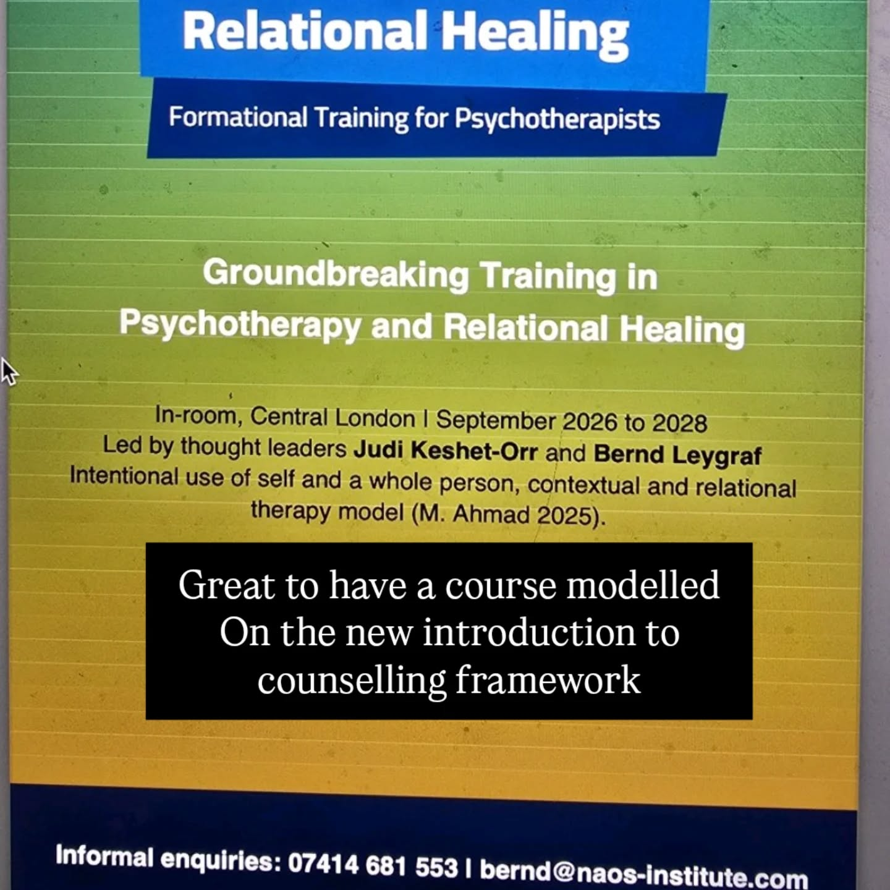
Wholeness Solution: Adopted tutors and organisations
Keele University
Caspari Foundation
Victoria Counselling & Training Service
Ellsmere Centre
Metanoia Institute
Warwick University
Link Centre (Assessing)
LJMU
NAOS Institute
Sesame Organisation
Anchorpoint training
IATE (Institute of Arts) Wellbeing Faculty
La Leche League
NCHP [UKCP School]
Training and socialisation with with BACP, UKCP, ACC, NCPS (Including training providers), BPC, CPCAB, etc.
Please let us know others
https://www.ldprh.org.uk
Notes:
Northfield Centre for Psychological Health
The Inner Compass Therapy Network
Silverleaf Psychotherapy Services
Open Pathways Mental Health Group
AnchorPoint Therapy & Consultation
The Reflective Mind Practice
BrightStone Counselling Services
MindSpring Counselling & Psychotherapy

Slide 12
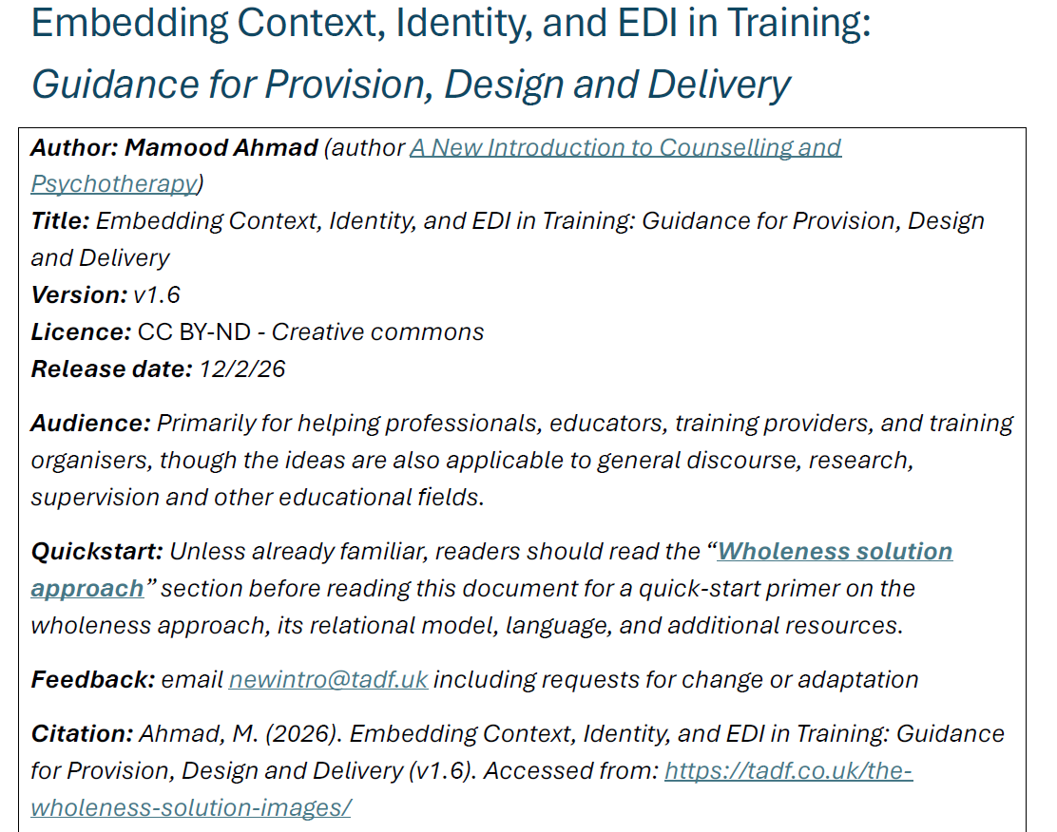

Slide 13
Wholeness in 5-Steps

Slide 14
Step 1/5: Change view of self

Slide 15
Self Experience v1.0 (As-is)
Gaps in fuller understanding of experience
Exclusion by invisibility which replicates into professional culture
Constricts whole population representation, knowledge, voice, lived experiences, empathy, barriers, and needs.
T
Experience
Inner and Interpersonal
Fragments understanding of self, context, their meanings to adaptations / later adds..
Notes:
No embodiment or social class.. Therefore where is that context?
In this view there is nothing that invites social class, money or determinants to be discussed explored

Slide 16


Good news: Secondary add-ons are universal and formative of the self
Mainstream Self (As-is)
Mainstream Self (To-be)
Transition
ANSWER: AVOID FRAGMENTATION

Slide 17
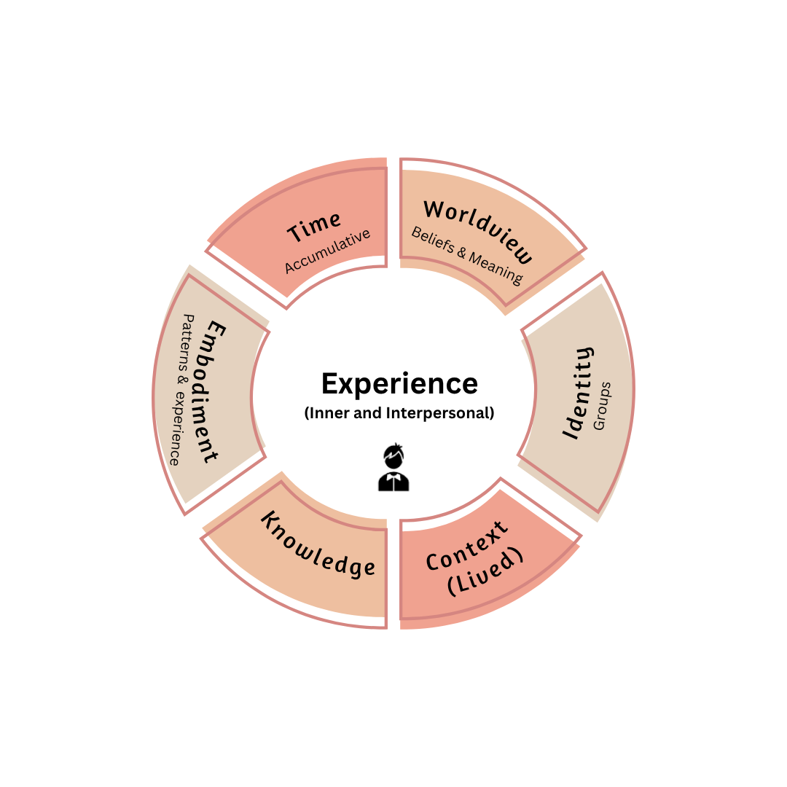
Self Experience v2.0 (To-be)
Use WICKET for remembering intersecting contexts
Strengthens gaps in understanding experience (represents secondary approaches) & whole positionality
Whole inclusion and fairness by visibility
Welcomes whole population experiences, representation, contextual empathy, knowledge, needs, and new possibilities
Makes whole rather than fragmented
Mandatory for structural strength and inclusion
Note: 2^{nd &} 3rd Level detail available
Whole Self © 2025 by Mamood Ahmad is licensed under CC BY-ND 4.0. To view a copy of this license, visit https://creativecommons.org/licenses/by-nd/4.0/
A New Introduction to Counselling and Psychotherapy [ Routledge books]
Notes:
Invites discussion of social positions, class, neighbour hood (context, resources) etc…
Worldview: superiority or not acting superior, communal bonds, and practical experience.
Identity: mutual aid, and collective responsibility, arts, belonging in community
Context: neightbourhoods, precarious living, gov policies
Knowledge: embodied, knowledge of institutions from “below” Working-class knowledge includes:
Practical, embodied expertise
Social intelligence
Survival strategies
Institutional insight
Moral frameworks
Community wisdom
Awareness of power and inequality
Emnodiement; manners, accent and class perfomance

Slide 18
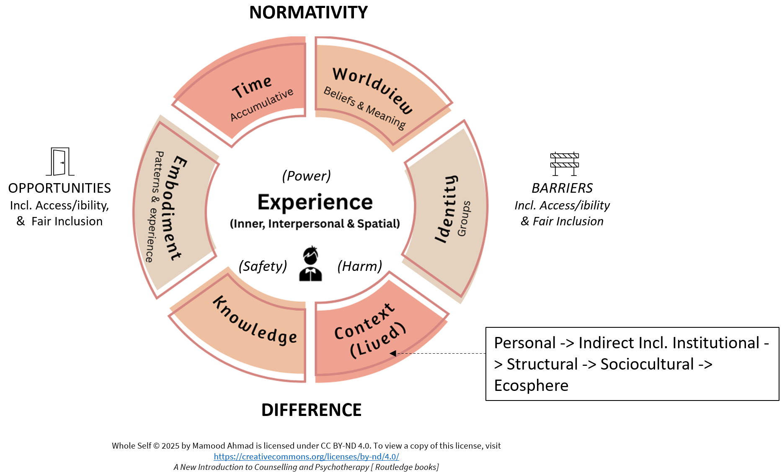

Slide 19
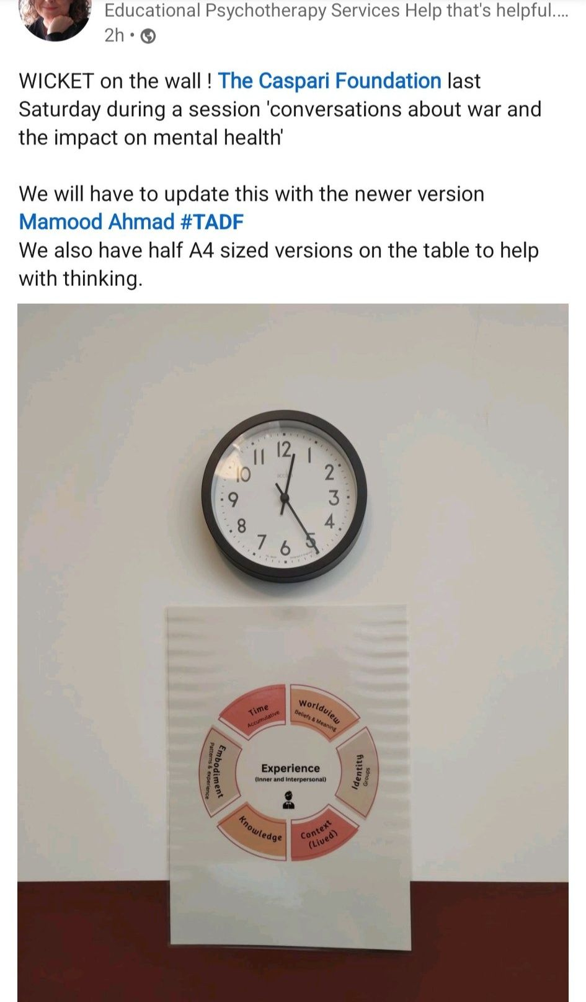
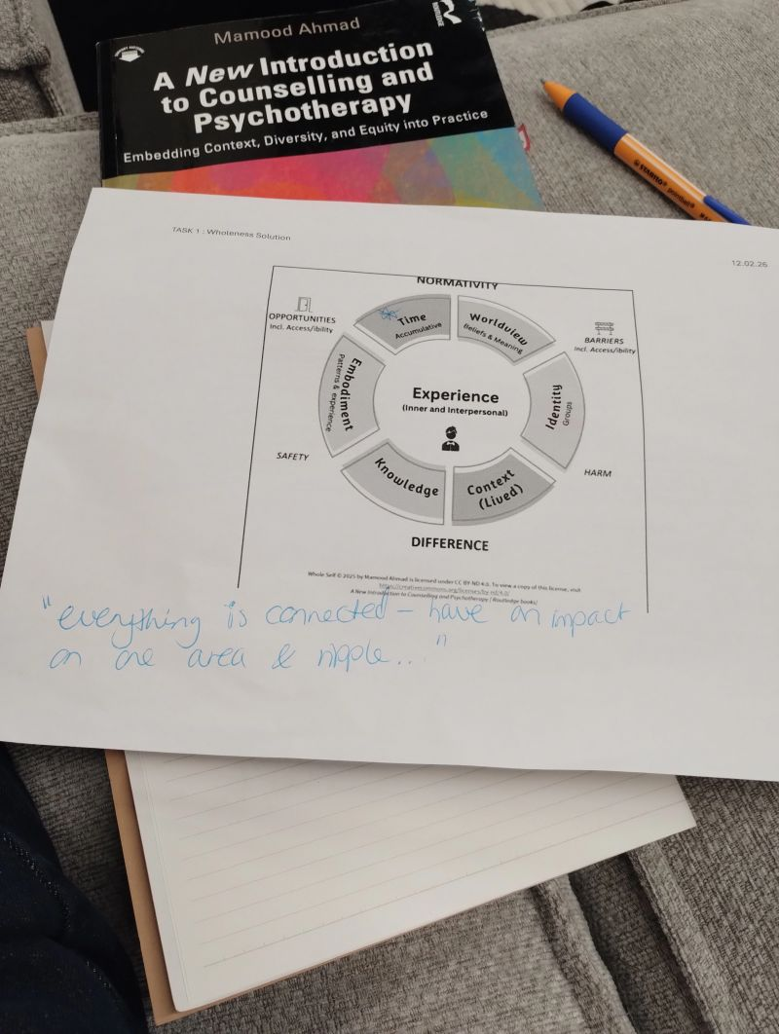
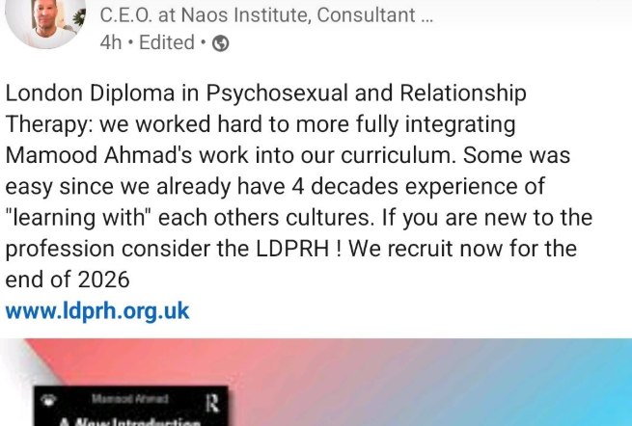
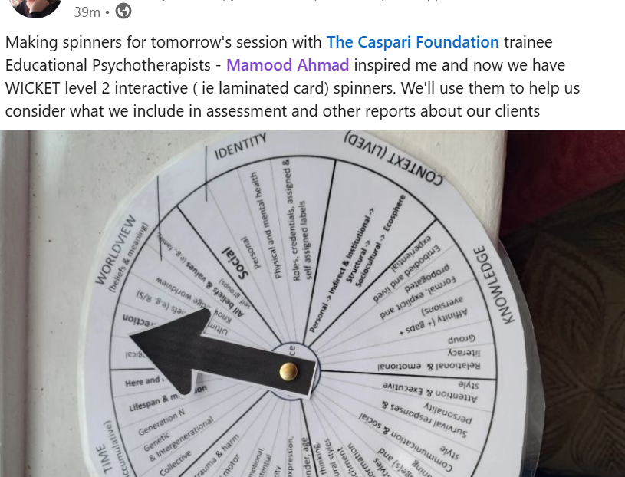
Pedagogy = Use cases

Slide 20
Pedagogy (WICKET)
1. Day 1
2. Self reference Exploration
3. Embedded in self
4. Continuation across all study and practice including supervision
5. Practice organisation ready

Slide 21

Level 2 - Self
TIME
(Accumulative)
In consideration of
DIFFERENCE, NORMATIVITY, OPPORTUNITY AND BARRIERS
WORLDVIEW (beliefs & meaning)
Generation N
Political and ideological
Meaning and direction
Here and now
Lifespan & migration
Ultimate beliefs (e.g. R/S)
Genetic
& Intergenerational
Knowledge and philosophical
Collective
Beliefs, ideals, morals & values (e.g., family, self, groups)
EMBODIMENT (EXPERIENCE)
Stress, trauma & harm
Sensory and motor
Social
Relational, sexual, emotional, existential & transcendental
Personal
IDENTITY
Physical and mental health
conditions
Health, pain, and capacity
Body interoception, expression,
image & aesthetic
Experience
Roles, credentials, other assigned or self assigned
Identity e.g.class, gender, age
Cognitive, processing, thinking, emotional & behavioural styles
Culture, events, resources, policy..
Individual->Personal(x) -> Indirect & Institutional(x) -> Structural ->
Sociocultural -> Planet
Relational & attachment
Learning & information processing styles
Language(s) and meaning
Embodied and lived
CONTEXT (LIVED)
Communication & social style
Formal, explicit and propogated
🌍
Survival responses & personality
Affinity, ideology & aversions
Relational & emotional literacy
Attention & Executive
Group & historical
Psycho- education
EMBODIMENT
(PATTERNS)
KNOWLEDGE
Notes:
Each context (e.g., family, institute) can be considered from lens of culture, events, resources, system, environment, structure, and history, barriers and opportunities.
Attention and Executive function
Sensory processing`
Communication, meaning and social interaction
Learning and information processing
Emotional regulation
Motor and coordination
Cognitive and thinking styles
Behavioural regulation
Interoception & Body Awareness
W - 7
Political & Ideological
Philosophical, scientific and rationalist
Alternative
Meaning and direction
Ultimate beliefs
In/Out groups
Beliefs
Knowledge - 5
Embodied and experiential
Affinity, gaps, aversion
Formal learning
Group
Relational and emotional
Context - 8
Stucture / Governance
History
Resources
Environment
Culture and messages
Knowledge
System
Opportunity & Access
Embodiment
Embodied patterns (6)
Neurodiversity
Relational & attachment
Language(s)
Learning styles
Communication styles
Personality
Embodied Experiences (7)
Age
Stress, trauma and window of tolerance
Sensory experience Senses, Sensations, Spiritual, Memories, Movement, Sexuality
Embodied expression (verbal, non-verbal, identity)
Rituals and behaviours
Health and capacity
Body aesthetic
Time
Here and now
Personal lifespan
Intergenerational
Collective
Generation
Figure 3. 1 Primary intersecting social Identities
Large, visible disfurement/disability, gender nonconforming.

Slide 22
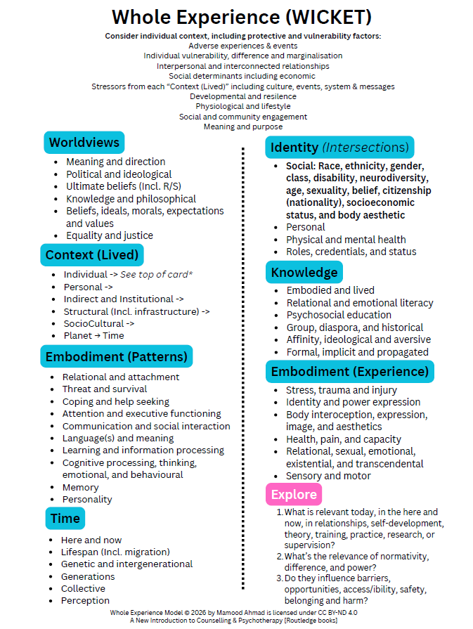
Continuous learning and reflecting on contextual aspects through training, supervison, and practice

Slide 23
Step 2/5: Change view of relationships

Slide 24
Relationship 1.0 (As-is)
Self Experience
Self Experience
Relationship
Personal
(Role power)
Doesn’t explicitly consider self and lived-in context in relationships
Limited relational scope = exclusionary of relational contexts (e.g., class, belief systems)
Individualised / decontextual empathy may be inadequate, shallow and harmful without explicit embedding of contexts (contextual empathy) (Ahmad, 2025)
Notes:
Again not representation in relationship

Slide 25
Relationship revisited
Separation of “the relationship” from secondary approaches
The relationship’ is considered to be singular.
Relationship is not knowledgeless (e.g., contextual empathy) to be relational
Not only intra/interpersonal relationships (e.g., group, institutes)
Mirroring of societal relations not acknowledged
Relationships arise from understanding (including contextual) which in turn lead to attunement of responses whether empathic, interventions, protocols, conceptualisation or to support client exploration.
Therefore, need to increase relational (empathic) scope or transference scope (psychoanalytic) (Ahmad, 2025, pg. 176)
Relational Scope
Good enough relationship is here
Good enough not always here
Below surface
Time
Relationship = D x S x T
Relational Scope © 2025 by Mamood Ahmad is licensed under CC BY-ND 4.0. To view a copy of this license, visit https://creativecommons.org/licenses/by-nd/4.0/

Slide 26
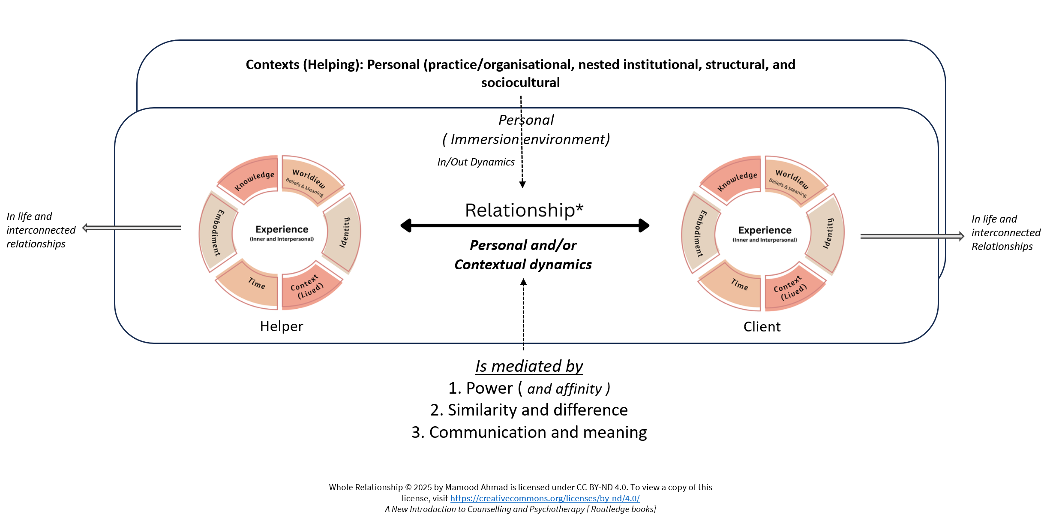
Relationship 2.0 (To-be)
* WICKET Embedded

Slide 27
Relationship 2.0 (To-be)
Relationship is key to the wholeness solution (embeds within relational ethics)
Mandatory for stronger, structurally inclusive and fairness through the visibility of relational scope
Welcomes (explicitly) whole population and ‘part’ experiences and their possibilities into the relationship for exploration and attuned responding
Relationship shift retains modality theory with minimal disruption or cost to curricula or practice

Slide 28
Step 3/5: Continually Embed Context (WICKET)
Apply context (WICKET) to assess, enrich and embed mainstream knowledge and practices
Self-Dev
Causation
Theory
Skills
Practice
Supervision
Research
Ethics
Competencies
W
Process
Domain X
(Context Embedded)
B&O
N&D
T
I
EXP
E
C
K
A simple process question: How does WICKET impact Domain X?
@ Mamood Ahmad 2026, From “A New Introduction to Counselling and Psychotherapy (Routledge Books)”.
Permission granted to share and reuse unmodified with attribution.

Slide 29
Example: Grief (Context Embedded)
Worldview: Influences meaning of loss, life and death, beliefs about justice, fairness and forgiveness, coping, and resilience
Identity: Caregiver identity, family expectations, norms in ethnic and national groups, gender roles and neurodivergence experience
Context (Lived): Norms of expression (stoic, emotional) including gender influences, community or family framework, rituals, who are more deserving of grief (disability, same-sex, stepparents, refugees, animals)
Embodiment: Relational patterns, relational experience, relational depth, style of grieving (seek support or avoid)
Knowledge: basis of what we belief (R/S, personal, science), theories (including personal), personal experiences, meaning and growth
Time (Accumulation): Impact of grief over life stages (child, teenage, adult), intergenerational and collective

Slide 30
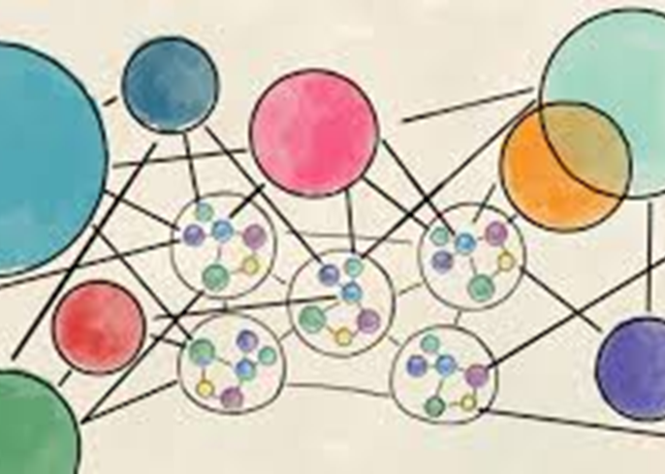
Step 4/5 – Build Consciousness
Build evidence informed consciousness of the social, mental health, and therapeutic ecosystem, the opportunities and barriers to change within it, and how it connects to personal and collective practices.
All things equal can we individually and collectively serve the whole population? Who is advantaged/disadvantaged

Slide 31
Service in Context Consciousness
Structural and sociocultural
Policy and influence
Service definition
Health and mental health ecology
Clients
Scope
Who
Access (address barriers)
Usability and accessibility
Adjustment (flexibility)
Responsiveness (Timeliness)
Environment
Communication
Policy and influence
Barriers
Service
Access
Policy and direct
Delivery culture
Delivery Organisation
Proficiency & curriculum
Governance
Service design
Culture and messages
Whole relationality
Deliver and measure
Proficiency
Whole teaching, learning and assessment standards
Whole relationality throughout
@ Mamood Ahmad 2026, From “A New Introduction to Counselling and Psychotherapy (Routledge Books)”.
Permission granted to share and reuse unmodified with attribution.

Slide 32
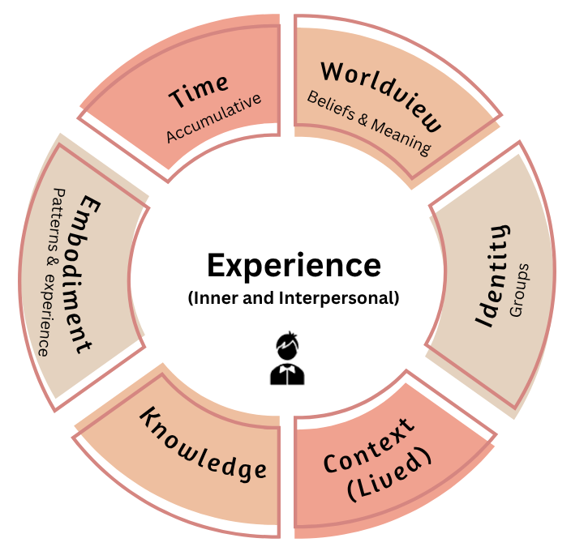
Embedded (Practice) Organisation
Service and Practice
4. Embed into service* (training or client service) and practice
3. Embed into governance, organisation culture, functions (e.g., Marketing/HR/Events), environment, and service design
Delivery Organisation
Standards & Proficiency
2. Embed into standards (and org policies), teaching, learning and assessment (including staff development)
1. Adopt wholeness solution model as reference for understanding relationships and individual/group barriers incl. access/ibility.
*Quality of service and practice is only as good as staff and organisation knowledge and proficiency.
Whole Self © 2025 by Mamood Ahmad is licensed under CC BY-ND 4.0. To view a copy of this license, visit https://creativecommons.org/licenses/by-nd/4.0/
A New Introduction to Counselling and Psychotherapy [ Routledge books]

Slide 33
Step 5 – Action Advocacy and Next Steps
Has the case been made?
Professional culture change not sustainable without augmented helping foundation
What can we action individually, in community, institutionally, and collectively?
Need advocates to come forward (communities, tutors, providers, & all)
Email newintro@tadf.co.uk

