Slide 1
Briefing
Slides and video recording for introducing new students or therapists to Whole Experience Model and Whole Relationship Model in educative and experiential manner
Video demonstration with live students here based on these slides: https://youtu.be/osIhiS6Isec?si=kXtu4GGL2MgKZgXX
Lecturer notes:
All slides are freely usable please reference the material and name: @ Mamood Ahmad 2026, From “A New Introduction to Counselling and Psychotherapy (Routledge Books). Permission granted to share and reuse unmodified images with attribution”.
Purpose is to experientially teach students / therapists importance of attuning to clients (through own experience)
Use live recording and use self to self-train first
Focus on student own self exploration and empathising/listening to others not dialogue with others
Support contact: newintro@tadf.co.uk

Slide 2

Whole Experience:
Self Development Session

Slide 3
Plan
Model contracting the space e.g., safety and confidentiality
Use self to demonstrate use e.g., what influences my current experience
Introduce the agenda and objectives
Pace educative, breakouts and reflection time
Sections – To cover core bold sections can be done in 3.5 hours full day is preferable.
  Introduction, aims and contracting
  Whole experience model exploration (most important section)
  Whole relational model exploration
  Whole experience model use cases
  Reflecting on power and social positions
  Reflecting on lived-in context [ can be left out ]

Slide 4
Agenda
Learning Outcome: To embed a Whole Experience Model within oneself, enabling a deeper understanding of self, others, and clients
Learning Objectives:
  Be able to describe why a Whole Experience Model is vital for creating stronger, equity-by-design learning and practice.
  Gain an experiential understanding of the Whole Experience Model
  Understand use cases for applying the Whole Experience Model.
  Be able to access resources for continuous learning.
Resources needed: Access to Whole Experience Reference Card

Slide 5
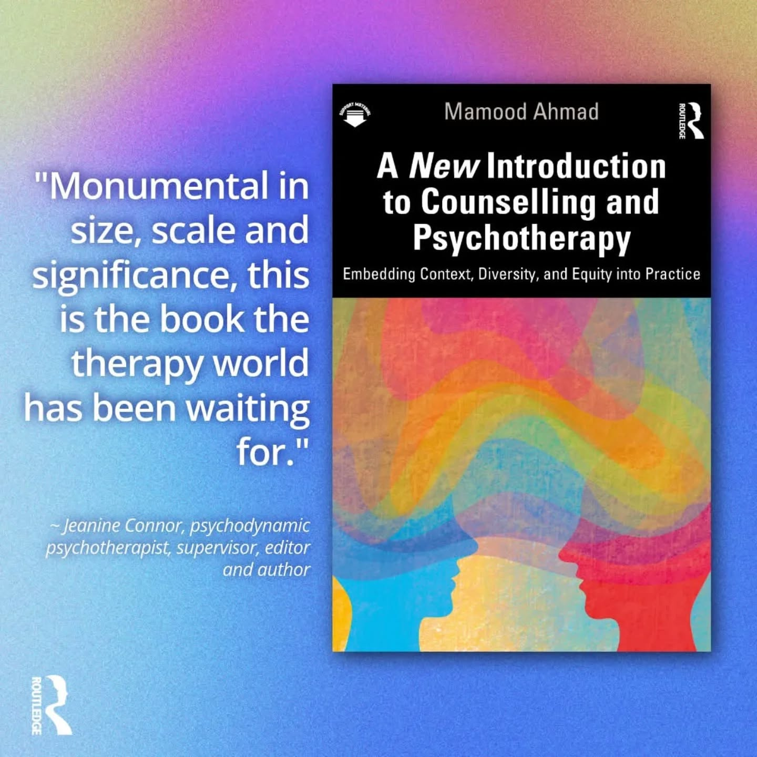
WHOLE EMBEDDED CURRICULUM IN A BOOK
+ ONLINE RESOURCES & LESSONS

Slide 6
Whole Experience (WICKET) Self Exploration

Slide 7
Experiential exercise
Exercise 1: What is influencing your experience in here and now?
< Tutor gives example >

Slide 8
Current Experience Model
Gaps in fuller understanding of experience
Exclusion by invisibility which replicates into training modules
Risks constricts whole population representation, knowledge, voice, lived experiences, empathy, barriers, and needs.
T
Experience
Inner and Interpersonal
Fragments understanding of self, context, their meanings to adaptations / later adds..
Notes:
No embodiment or social class.. Therefore where is that context?
In this view there is nothing that invites social class, money or determinants to be discussed explored

Slide 9
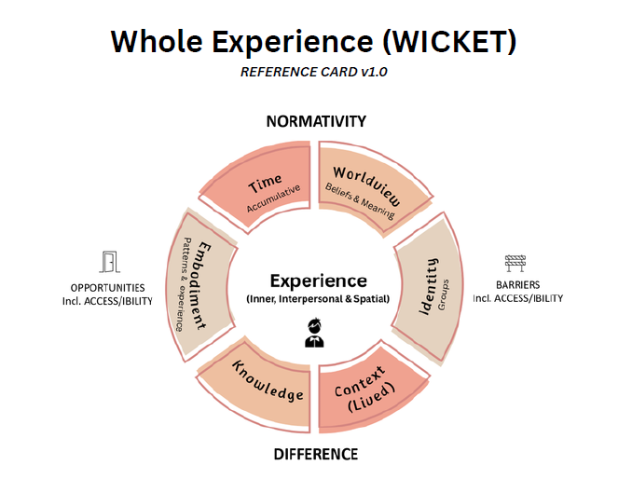

Slide 10
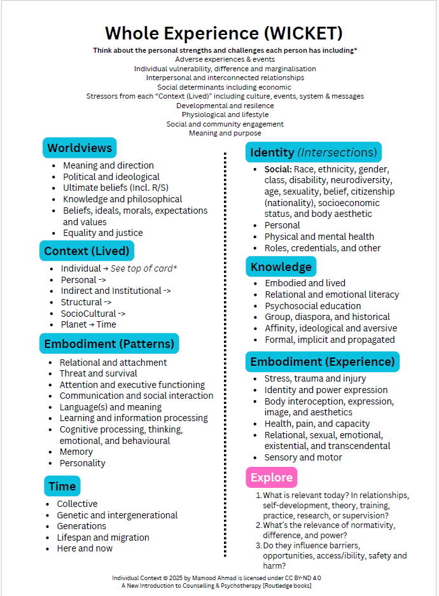

Slide 11
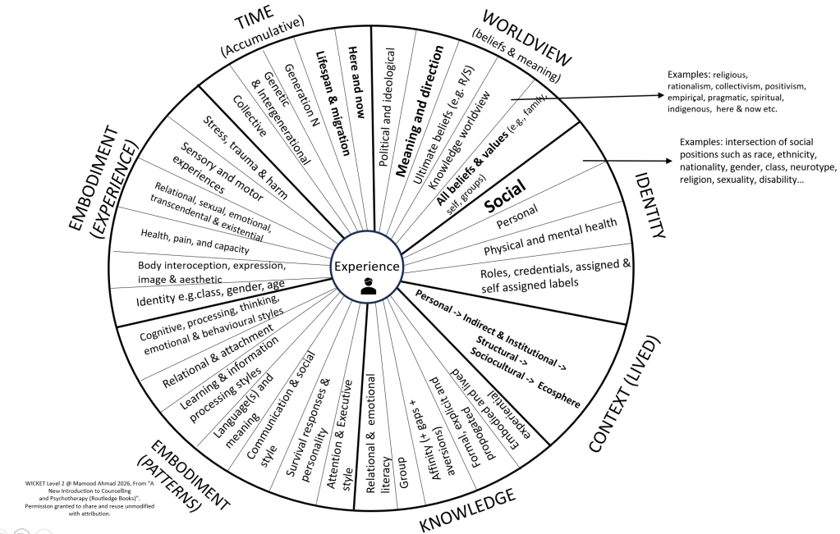
Level 2 - Self
Each from consideration of
DIFFERENCE, NORMATIVITY, OPPORTUNITY AND BARRIERS

Slide 12
Breakout
Discuss and clarify understanding of the model

Slide 13
Breakout
Introduce yourself through aspects of WICKET model including BOND (Barriers, Opportunities, Normativity or Difference)
< Tutor gives example >

Slide 14
Relationship 1.0 (As-is)
Self Experience
Self Experience
Relationship
Personal
(Role power)
Doesn’t explicitly consider self and lived-in context in relationships
Limited relational scope = risks exclusionary of relational contexts (e.g., class, belief systems)
Individualised empathy may be inadequate, shallow and harmful without explicit embedding of contexts (contextual empathy) (Ahmad, 2025)
Notes:
Again not representation in relationship

Slide 15
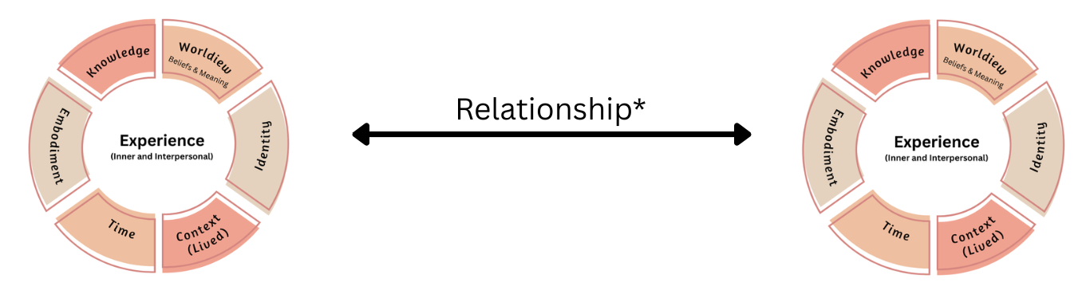
The (Whole Embedded) Relationship
Embeds the whole into relationships (personal and/or contextual)
Client
Helper
* WICKET Embedded
@ Mamood Ahmad 2026, From “A New Introduction to Counselling and Psychotherapy (Routledge Books)”.
Permission granted to share and reuse unmodified with attribution.

Slide 16
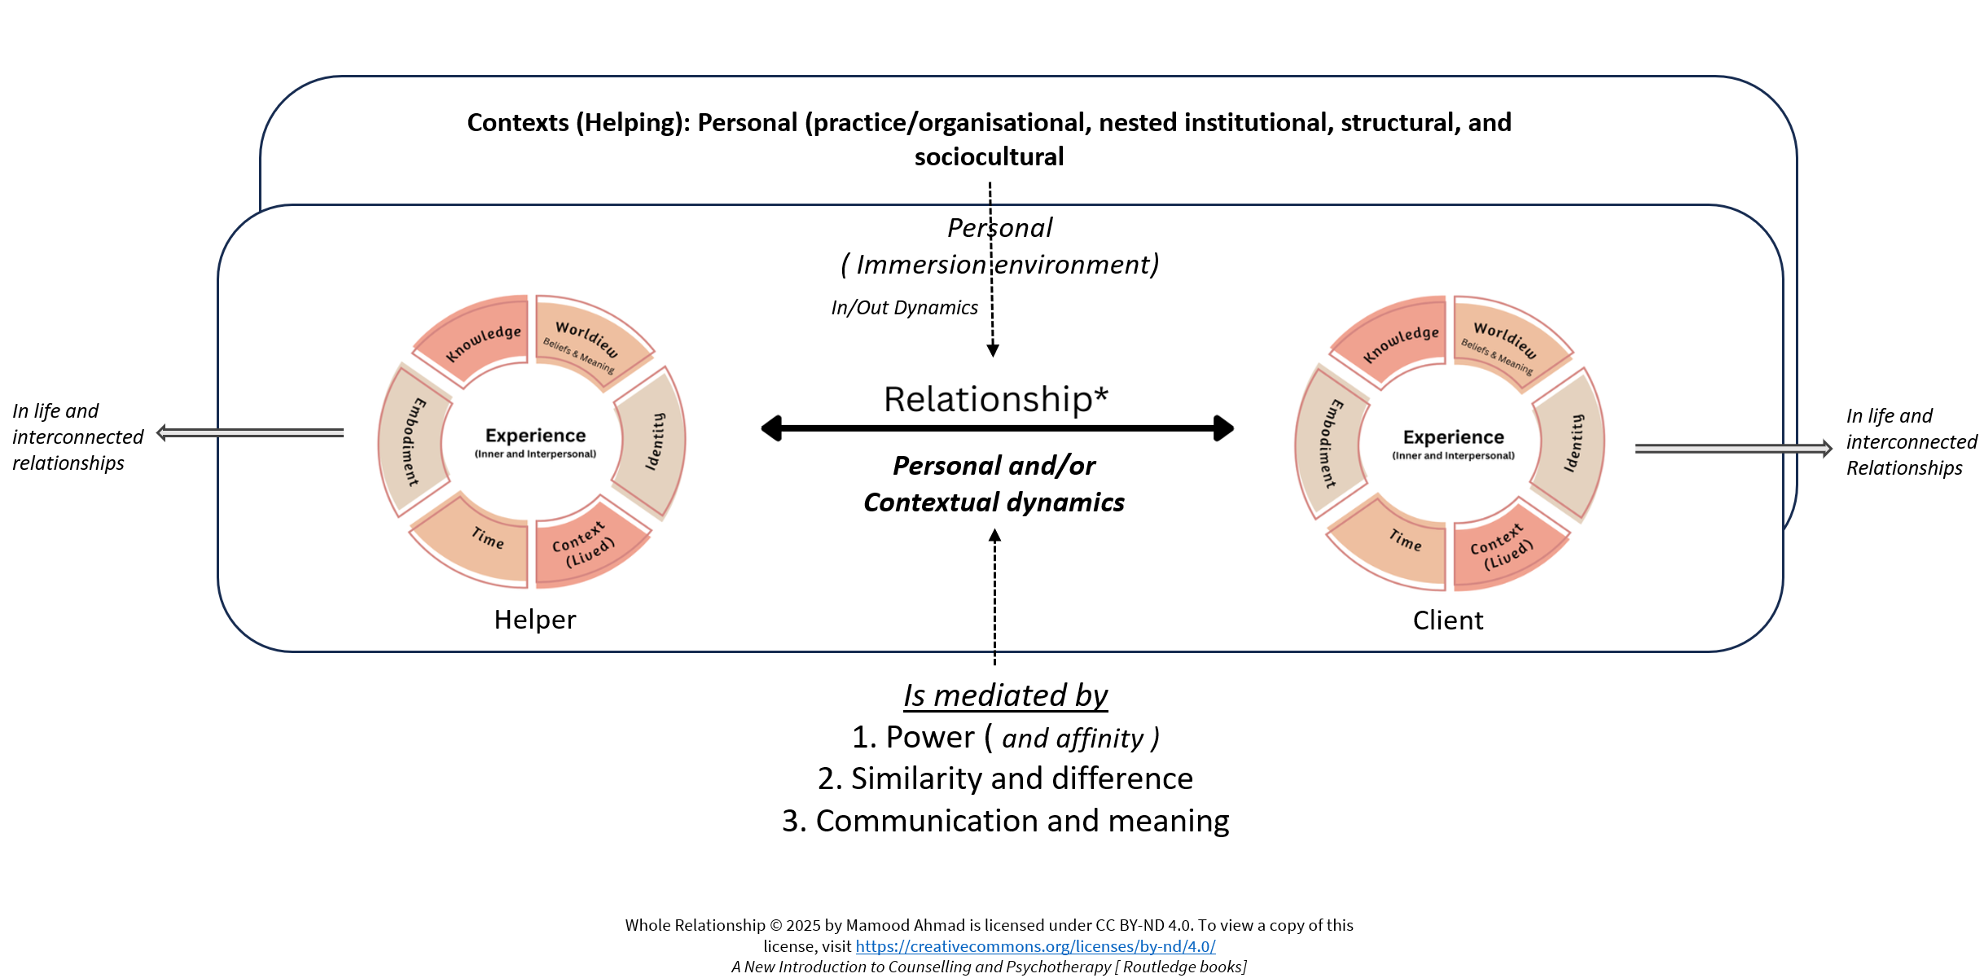
Relationship 2.0 (To-be)
* WICKET Embedded
Notes:
The image presents a symmetrical model illustrating the concept of Relationship* (denoted by a double-headed arrow) between two entities labeled Client and Helper.
Both the Client and the Helper are depicted as having an Experience (defined as Inner and Interpersonal) at the center, which is surrounded by a ring of six interconnected factors:
Knowledge
Worldview (Beliefs & Meaning)
Identity
Context (Lived)
Time
Embodiment
This model suggests that a therapeutic or helping relationship is established through the interaction and shared space between the complex, multi-layered experiences of two people, where each person's experience is fundamentally shaped by these six core components. The subtle variations in color within the factors might indicate different layers or aspects of each component, such as explicit vs. implicit knowledge or past vs. present time.

Slide 17
Relational Scope (Ahmad, 2026, pg 176)
Relational Scope
Good enough relationship is here
Good enough not always here
Below surface
Time
Relationship = D x S x T
Relational Scope © 2025 by Mamood Ahmad is licensed under CC BY-ND 4.0. To view a copy of this license, visit https://creativecommons.org/licenses/by-nd/4.0/
Notes:
Increases scope – promotes exploration of MH on experience and discrimination and barriers.

Slide 18
Breakout Reflection
How might your WICKET-BOND positionality impact relationships with clients or more generally (facilitative and / or barriers)?
< Tutor gives example >

Slide 19
Whole Experience Model (WICKET) Use cases
Purpose is to continually reference back to enable ideas to be continually embedded
  Learning in dialogue: E.g., Spin the WICKET wheel
  Essays and case studies
  Training
  Group relationships and process
  Own therapy
  Supervision
  Research
  Client Work

Slide 20
Use Case 1: Positionality: 6 Parts of positionality (WICKET)
Experience is shaped and influenced by.. Who is Inside/Outside of Experience
W - Worldview
I - Identity
C – Context (Lived) including immersion cultures (place)
K - Knowledge
E - Embodiment
T – Time
Each contributes to experience (person/persons and spaces) and influences barriers and opportunities (e.g., normativity/difference)

Slide 21
Use case 2: Continually apply (WICKET)
Apply context (WICKET) to assess, enrich and knowledge and practices
Self-Dev
Causation
Theory
Skills
Practice
Supervision
Research
Ethics
Competencies
W
Process
Domain X
(Context Embedded)
B&O
N&D
T
I
EXP
E
C
K
A simple process question: How does WICKET impact Domain X?
@ Mamood Ahmad 2026, From “A New Introduction to Counselling and Psychotherapy (Routledge Books)”.
Permission granted to share and reuse unmodified with attribution.

Slide 22
Example: Grief (Context Embedded)
Worldview: Influences meaning of loss, life and death, beliefs about justice, fairness and forgiveness, coping, and resilience
Identity: Caregiver identity, family expectations, norms in ethnic and national groups, gender roles and neurodivergence experience
Context (Lived): Norms of expression (stoic, emotional) including gender influences, community or family framework, rituals, who are more deserving of grief (disability, same-sex, stepparents, refugees, animals)
Embodiment: Relational patterns, relational experience, relational depth, style of grieving (seek support or avoid)
Knowledge: basis of what we belief (R/S, personal, science), theories (including personal), personal experiences, meaning and growth
Time (Accumulation): Impact of grief over life stages (child, teenage, adult), intergenerational and collective

Slide 23
Reflecting on power and social positions

Slide 24
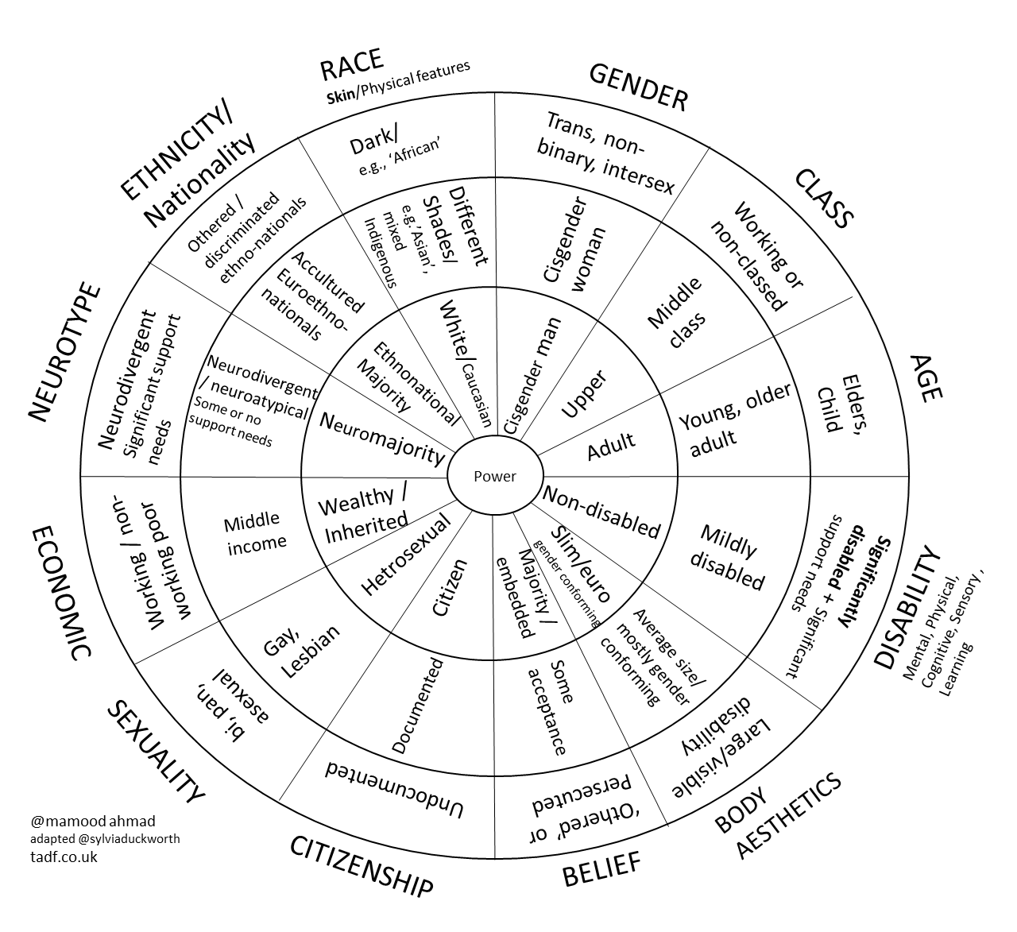
Intersectionality
“[ As a east asian woman] I face discrimination as white women but also as a black woman. Similar, different and unique discrimination”
I was constantly discriminated against because of my poverty and those wounds still run very deep...[But] The concept of intersectionality recognizes that people can be privileged in some ways and definitely not in others." ~Gina Crosley-Corcoran

Slide 25
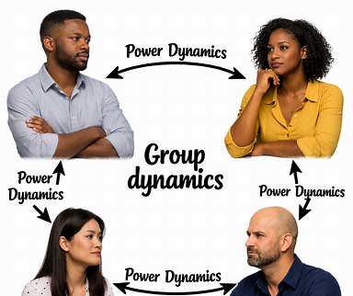
Power and Affinity
Uses and abuses
Hierarchies may mirror societal relationships and thus power relationships
Between & within groups
Power in Role, Personal, Societal (Procter)
Power in Culture: Affinity to cultural norms and expectations
  Worldviews and beliefs, Lifestyles and relationship, communication styles, morality & beliefs (Ahmad, 2026)
Affinity to similarity, norms and status
Personal & contextual dynamics in groups

Slide 26
Rupture, Repair and Accountability
Tutor note: Not in live recording but important to help students reflect on experiences of rupture, best practice repair and importance of accountability.
Pre-rupture and rupture
Repair and restoration
  What is self agenda?
  Consider power dynamics and societal meaning of rupture
  What part(s) did you play in rupture?
  Who is responsible for repair?
  Broaching repair
  Time and process may be long
  Accountability for your part

Slide 27
Breakout: Power
What is you experience of power? Power and powerlessness
What personal, role, status, societal, cultural power do you have?
  Reflect on the full WICKET and Intersectional Wheel
What is your norm in terms of conflict resolution and difficult conversations? What is your edge of development?
<Tutor models example >

Slide 28
Breakout: Power
What is you experience of power? Power and powerlessness
What personal, role, status, societal, cultural power do you have?
  Reflect on the full WICKET and Intersectional Wheel
<Tutor models example >

Slide 29
Reflecting on Context (Lived)

Slide 30

Time
(Incl. Historical context)
Planet
Experience is formed from Intra, Interpersonal and Context interplay
Socio-Culture
Structural
Indirect & Institutional
Personal
Individual
Individual experience
Harm and Safety mediating by individual, interpersonal and contextual factors not only individual
Notes:
Individual experience is shaped by WICKET-BOND

Slide 31
Reflection
What are some examples of Context (Lived) that may impact experience? E.g., norms and expectations, lack of resources
How do your lived-in context(s) e.g., culture, environment, impact your experience?
Consider individual factors from the reference card (top)
  Consider individual context, including protective and vulnerability factors:
    Adverse experiences & events
    Individual vulnerability, difference and marginalisation
    Interpersonal and interconnected relationships
    Social determinants including economic
    Stressors from each “Context (Lived)” including culture, events, system & messages
    Developmental and resilence
    Physiological and lifestyle
    Social and community engagement
    Meaning and purpose

Slide 32

Summary and next steps
Continuous reference point for all subjects – What if scenarios
Apply various use cases
Additional resources: tadf.co.uk
Email: admin@tadf.co.uk for support and feedback
Tell others…
Good luck with your studies!

