Slide 1
Briefing
Slides and video recording for introducing new students or therapists to Whole Experience Model and Whole Relationship Model in educative and experiential manner
Video whole induction day model for trainers with live students here based on these slides found tadf.uk: or shorter demonstration https://youtu.be/osIhiS6Isec?si=kXtu4GGL2MgKZgXX
Lecturer notes:
All slides are freely usable please reference the material and name: @ Mamood Ahmad 2026, From “A New Introduction to Counselling and Psychotherapy (Routledge Books). Permission granted to share and reuse unmodified images with attribution”.
Purpose is to experientially teach students / therapists importance of attuning to clients (through own experience)
Use live recording and use of self to self-train first
Focus on student own self exploration and empathising/listening to others not dialogue with others
Support contact: newintro@tadf.co.uk

Slide 2
Preliminaries
Welcome
Run primarily as a day 1 induction in C&P training (model for tutors)
Not expected to know or explore everything wholeness framing
  As used framing throughout training / practise
Resources needed for induction day: Access to Whole Experience and Relationship Reference Card, WS Dictionary
Give students all follow on resources available : https://tadf.co.uk/standards/
Email for support/questions: newintro@tadf.co.uk

Slide 3

Student Training Induction Day:
The Wholeness Solution
Social Context & EDI and Antidiscrimination Embedded Everywhere by Design

Slide 4
Student Training Induction Day:
The Wholeness Solution
Social Context & EDI and Antidiscrimination Embedded Everywhere by Design

Slide 5

Training Induction Day:
The Wholeness Solution
Social Context & EDI and Antidiscrimination Embedded in Experience and Relationships

Slide 6
Agenda
Learning Outcome: To embed a Whole (Lived) Experience and Relationship frame of understanding within oneself, enabling a deeper understanding of self, others, and clients throughout training, practise and life.
  Through understanding and experiential use of self
  Terms
    Training and Practise interchangeable
    Whole : everything together not separate
    “Relationship” vs “Analytic Scope”

Slide 7
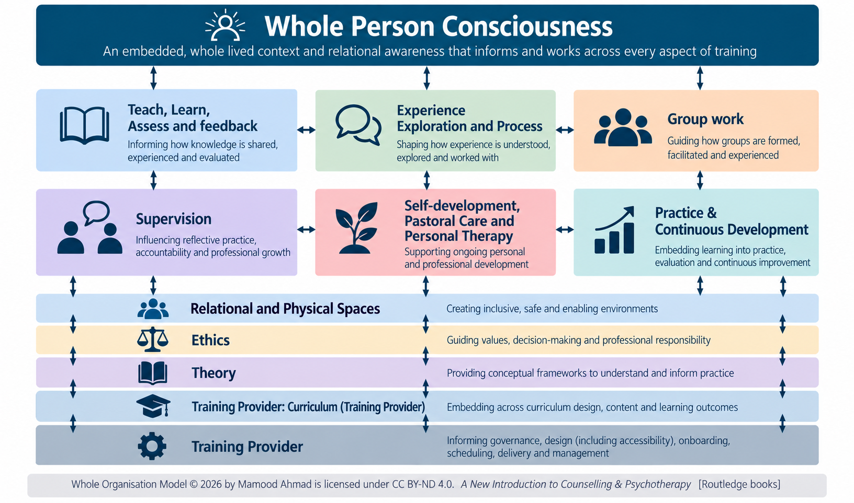
Scope: Use within in everything we do

Slide 8
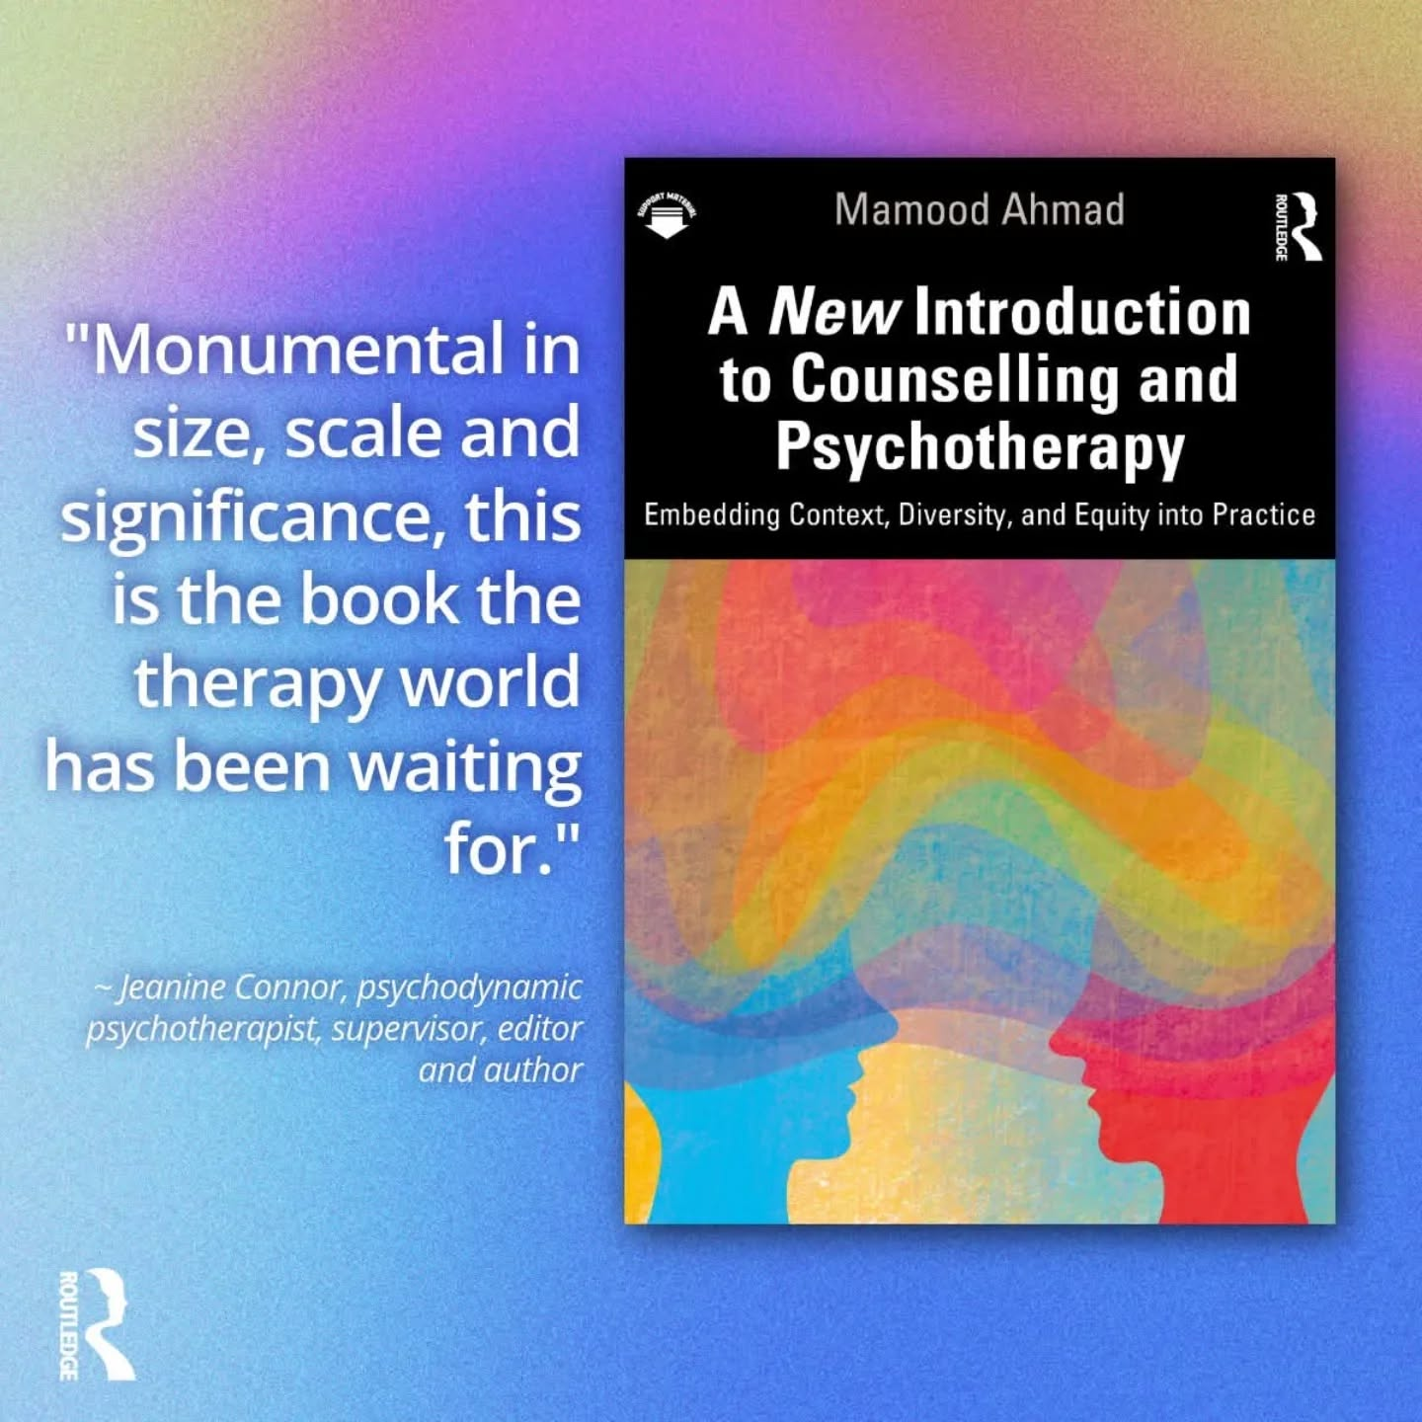
WHOLE EMBEDDED CURRICULUM IN A BOOK

Slide 9
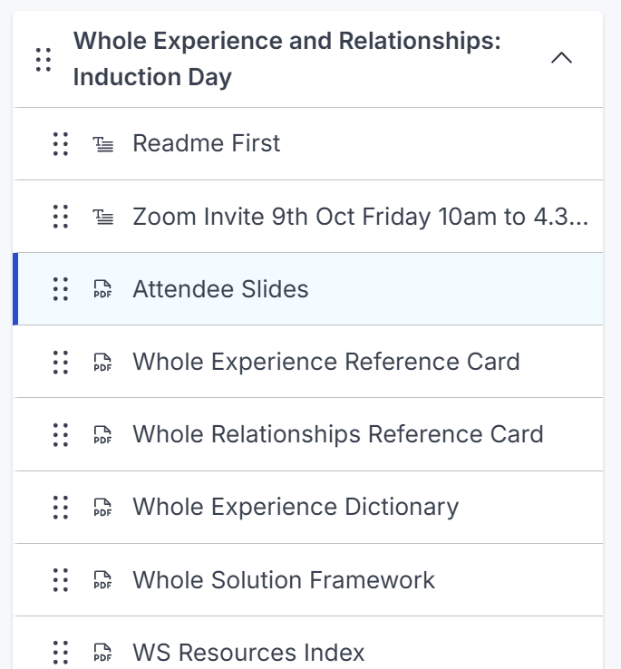
Resources

Slide 10
Whole “Lived” Experience Exploration

Slide 11
Exercise 1: Whole Experience
Exercise 1: What is influencing your experience in here and now?
Self Awareness Exercise
< Tutor gives example >

Slide 12
Whole Experience Terms
Lived experience the person's actual subjective experience of their world, relationships, feelings, thoughts and circumstances.
Phenomenology. A way of exploring / understanding of how experience is experienced from the person's perspective
Self-awareness and reflective practice exploring the experience (self, client)
Theoretical ways of exploring vary
  CBT: How does the person think and experience the situation?
  Psychodynamic: How might this experience be connected to deeper or unconscious patterns?
  Person-centred: What is this experience like for the person, in their own terms? (e.g., what's its like not to be understood)
    E.g., “Experience (noun). This term is used to include all that is going on within the envelope of the organism at any given moment which is potentially available to awareness.”
    — Carl Rogers, 1959, p. 197

Slide 13
Current Experience Model
Gaps in fuller understanding of experience
Exclusion by invisibility which replicates into training modules
Risks constricts lived experience, whole population representation, knowledge, voice, empathy, barriers, and needs.
T
(Individual lifespan)
Experience
Inner and Interpersonal
Fragments understanding of self, context, their meanings to adaptations / later adds..
Notes:
No embodiment or social class.. Therefore, where is that context?
In this view there is nothing that invites social class, money or determinants to be discussed explored

Slide 14
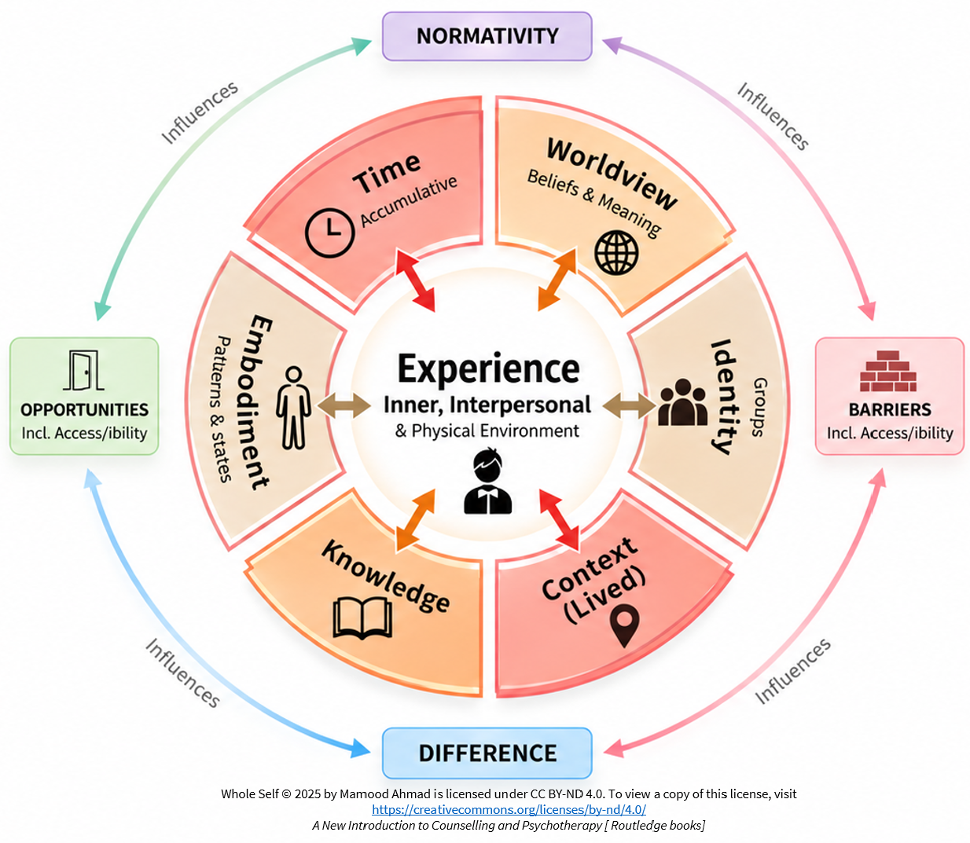
Whole Experience Model
Remember: [II-WICKET-BOND]

Slide 15
Purpose of Whole Experience:
Remember: II-WICKET-BOND
Describes intra-, interpersonal, and contextual experiences as a whole.
  Shorthand to remembering: II-WICKET-BOND
Allow us to inform exploration, relationships, case conceptualisation, theory, supervision, and other aspects of practice.
  The aim of II-WICKET-BOND is not to explain away someone's experience, but to widen our lens. Rather than asking, "What's wrong with this person?" we ask, "What influences are shaping this experience?" This creates richer conceptualisation, deeper curiosity, and more attuned and compassionate understanding.
WICKET Contextualisation is necessary to adjust to needs (e.g., embodiment in relationship, adjustments and accommodations, access, accessibility)
Must internalise (embed) the framework through repeated use so it naturally sits in the background but can be brought into the foreground when needed.

Slide 16
6 Parts of context (WICKET-BOND)
Intra and interpersonal experience is shaped and influenced by six high level intersecting contexts.. Each of which may be normative/different and present opportunities and barriers (BOND)
W – Worldview: Ways of viewing and making sense self, others and the world
I – Identity: Personal and social identities
C – Contexts (Lived): including individual, direct (e.g., family), institutional, structural, sociocultural immersion contexts (including contextual cultures, events and histories)
K – Knowledge: Ways of knowing
E – Embodiment: Mind body patterns and embodied experiences
T – Time: Personal, group and historical (including events and histories)

Slide 17
Ways of understanding WICKET-BOND [1]
Worldview –
Experience: A person feels guilty for not intervening in a bullying incident.
Worldview factor: Someone with a strong sense of fairness and awareness of harm may feel a greater responsibility to intervene. Not acting can result in moral distress or a sense of having failed to uphold their values.
Identity:
Experience: A woman feels she is "not brave" because she did not feel safe walking home alone at night.
Identity factor: Women's experiences of safety are shaped by the reality of violence against women and girls (VAWG). Experiences may also differ across intersecting identities, including for trans women and gender non-conforming people.

Slide 18
Ways of understanding WICKET-BOND [4]
Barriers impacting experience
A person in need cannot get access to therapy
A person feels powerless to act after feeling exhausted navigating health services
Opportunity impacting experience
A person feels confident they are what jobs normally look for in individuals (polish and professionalism, normativity)
A person has a strong social network of contacts to draw upon for support and opportunities
Normativity and Difference (and Difference within Normativity)
Within LGBTQIA+ Community I wont face othering because of being Gay. However, as a Transperson I feel excluded from LGB community (Difference)

Slide 19
Exercise 2: Consolidate understanding
Discuss and clarify understanding of the model

Slide 20
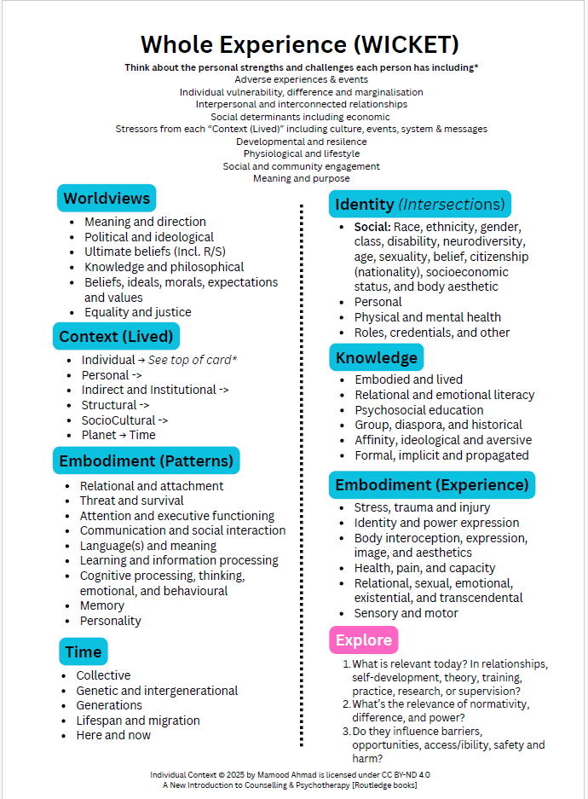
DOWNLOAD
REFERENCE CARD

Slide 21
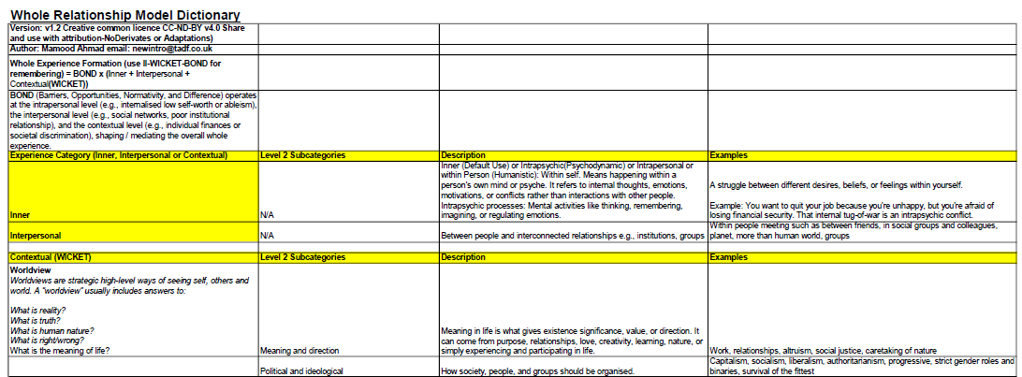
DICTIONARY
REFERENCE CARD

Slide 22
Exercise 3: Introduce yourself
Which WICKET parts of your experience ( and / or of your communities & contexts ) would you ideally like others to understand/accept/adjust to with less friction, effort and/or less education?

Slide 23
Whole Experience (2): Lived Context (The “C” in WICKET) Exploration
The “C” in WICKET

Slide 24
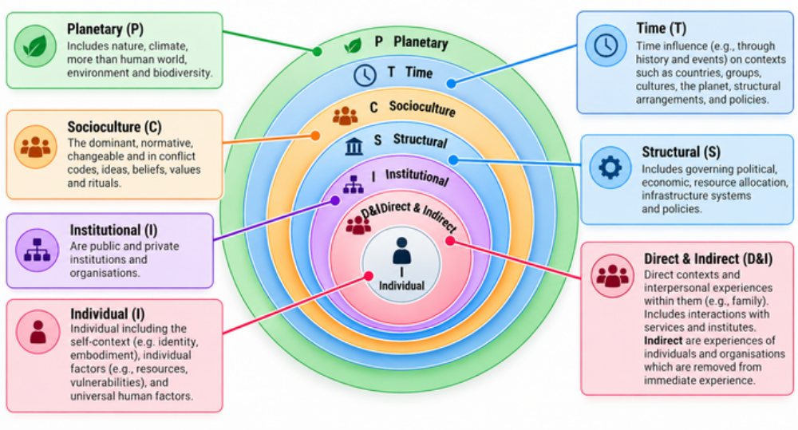
The “C” in WICKET: Lived Context

Slide 25
Exercise 4: Clarify Understanding
Discuss and clarify understanding of the C in WICKET (Lived Context) framework

Slide 26
Exercise 5: Exploring Lived Context
How does the wider world impact your experience (at any stage or now)?
  Consider: Sociocultural, institutional, planet, and structural/international world impact your experience?

Slide 27
Exercise 5 (optional): Exploring Lived Context
How does your individual (see top of reference card for ideas) and direct lived contexts impact your experience (at any stage or now)

Slide 28
Individual Context
Consider your individual factors from the reference card (top)
  Consider individual context, including protective and vulnerability factors:
    Adverse experiences & events
    Individual vulnerability, difference and marginalisation
    Interpersonal and interconnected relationships
    Social determinants including economic
    Stressors from each “Context (Lived)” including culture, events, system & messages
    Developmental and resilience
    Physiological, safety and lifestyle
    Social and community engagement
    Meaning and purpose

Slide 29
Whole Experience (2): Identity (The “I” in WICKET) Exploration
The “I” in WICKET

Slide 30
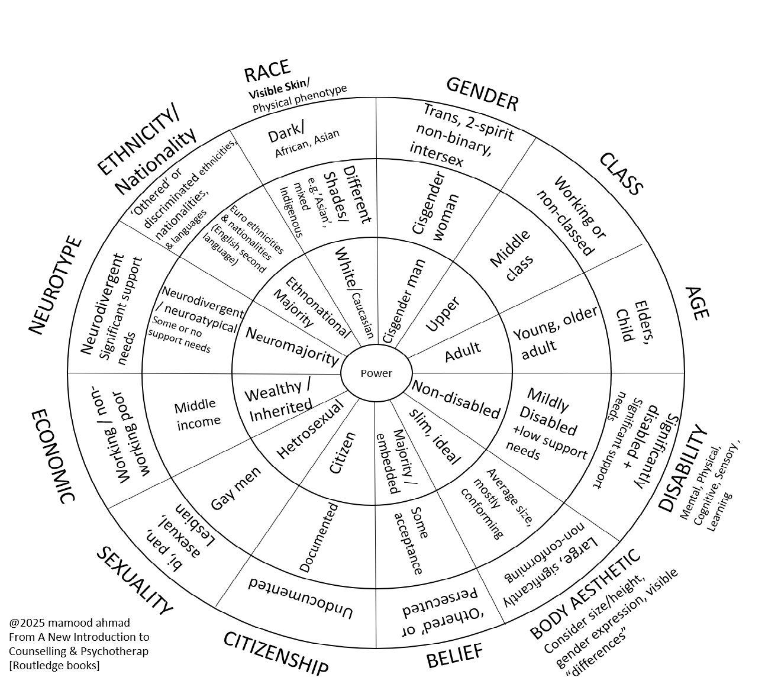
The “I” in WICKET

Slide 31
Quiz
What does II-WICKET-BOND stand for?
What is it and its purpose?
What sub-models and artefacts does it consist of?
Which theories can use?

Slide 32
Whole Relationship Exploration

Slide 33
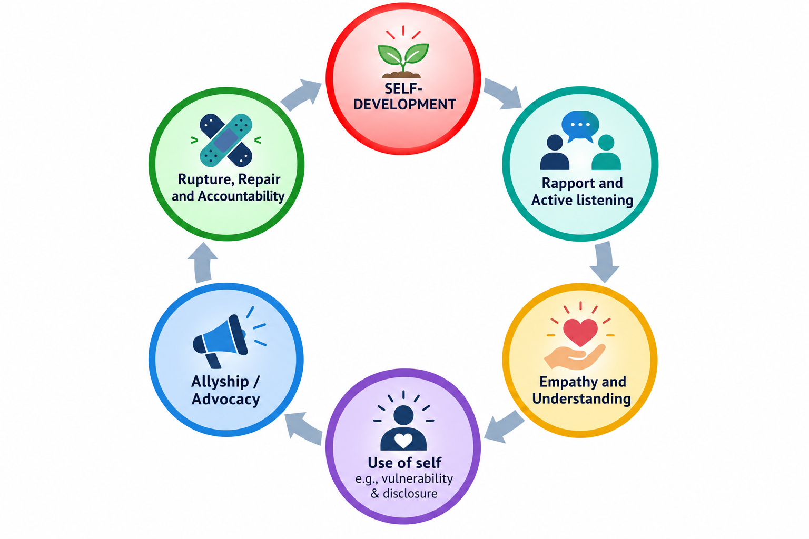
Relationship Building Blocks
Relational Ethics & Attunement (Embeds WICKET-BOND)

Slide 34
Relationship 1.0 (As-is)
Self Experience
Self Experience
Relationship
Personal
(Role power)
Doesn’t explicitly consider self and lived-in context in relationships
Limited relational scope = risks exclusionary of relational contexts (e.g., class, belief systems)
Individualised empathy may be inadequate, shallow and harmful without explicit embedding of contexts (contextual empathy) (Ahmad, 2025). Chronic and enduring empathic failure.
Notes:
Again not representation in relationship

Slide 35
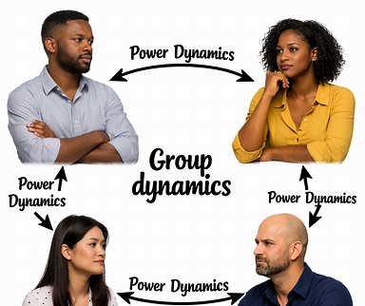
WICKET-BOND also exists in ALL relational dynamics
Relational processes are informed by personal and/or contextual WICKET-BOND factors
A Question of safety: Do your or group recognise “Context” as embedded into and thus part of the relationship? Will stress from my relatively “upper” social advantages be “Othered”
Therefore, building relationships, empathy and understanding, dialogue, rupture, repair are all informed by these dynamics
Relational Experience + WICKET

Slide 36
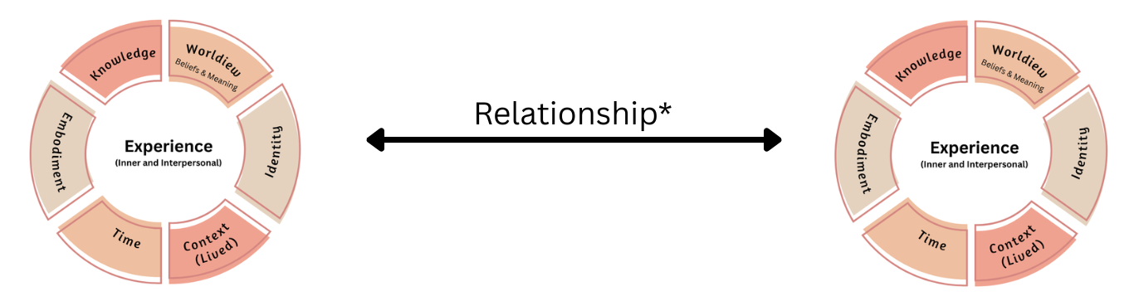
Whole Relationship
Personal (inner/interpersonal)
and/or contextual dynamics)
Client
Helper
* WICKET Embedded
@ Mamood Ahmad 2026, From “A New Introduction to Counselling and Psychotherapy (Routledge Books)”.
Permission granted to share and reuse unmodified with attribution.

Slide 37
Relationships are all
Intra-Interpersonal-Contextual
Embodied prejudice and embodied acceptance (Ahmad, 2025)
WICKET also form lived experience within relationships
Context provides deeper non-fragmented reflection of the whole experience
Hi, I’m a therapist. What do you do?
I’m an Uber driver
Ah, I see. Interesting < Silence >
Notes:
Example of embodied relationship dynamics and bias. Would this have happened if they were also working class

Slide 38
Exercise 8: Clarify Understanding
Discuss and clarify broad understanding of the whole relationship model

Slide 39
Whole Relationship (Relationship 2.0)
Context (Helping)*:
Personal (Practice/organisational) -> Indirect and Institutional (Helping ecosystem) -> Structural (Policy and resource) -> Sociocultural (Ideas and norms) -> Time (History)
In/Out Dynamics
Spatial Environment
In life and interconnected
relationships
In life and interconnected
relationships
Personal and/or Contextual dynamics
Helper
Client
*Is mediated by
1. Power ( and affinity )
2. Normativity, Similarity and difference
3. Communication and meaning
4. Historical experience
Whole Relationship © 2025 by Mamood Ahmad is licensed under CC BY-ND 4.0. To view a copy of this license, visit https://creativecommons.org/licenses/by-nd/4.0/
A New Introduction to Counselling and Psychotherapy [ Routledge books]

Slide 40
Power and affinity
Consider how power dynamics impact on relationships : uses and abuses
Types of Power: Personal, Role, Societal, Cultural (Procter): Culture and Status (Ahmad)
  Worldviews and beliefs, experiences, lifestyles and relationship, communication styles, morality & beliefs (Ahmad, 2026)
Affinity to similarity, norms and status
Relational hierarchies may mirror societal relationships and thus power relationships
Between & within groups
Personal & contextual dynamics in groups

Slide 41
Exercise: Power
What are your experiences of power and powerlessness as well dynamics in groups (including affinity)?

Slide 42
Exercise: Similarity and Difference
How might similarity and difference impact relationships?
What has been your experience?

Slide 43

Communication and meaning [1]
Do we understand each other? What do we really mean?
Examples
  Style and Accessibility
  Attuned Language
  Jarring, Othering or Discriminatory Language
  Multi-Lingual meaning
  Language as identity
  Social and communication styles (e.g., Neurodiversity)
  Interpreter
  Code switching and masking

Slide 44
Comms and Meaning [2]: “Othering” Language
Deeper than what to say but full of meaning
  Attune to client + language associated with communities of difference
Examples:
  Silence
  Imagery
  Ignoring context (e.g., group level history, the social situation) in understanding
  Debating lived experience especially as an outsider
  Demands to educate
  Where are you “really” from?
  Names and pronouns
  You don’t look Autistic
  Your one of us not like them
  Allyship to group rather than what you feel is “just” / Singled out “other”

Slide 45
Exercise: Language: Verbal and non-verbal
What language do you feel “othered” (pushed away) with?
  Consider childhood and social discrimination, and invisibility of parts of you?

Slide 46
In Life Relationships
(Barriers, health, and facilitators also in these relationships)
Relationship [1]
Personal and/or
contextual dynamics
Interpersonal and self relationship
Groups, roles, communities, culture & society, past and future generations (Time)
Infrastructure, technology &
non-sentient AI
Knowledge, ideas
and worldviews (limits, implicit, explicit)
Institutes including public and private sector, e.g. profession, workplace, schools, justice system.
Governing structures, political, economic, infrastructure, e.g., access, policies and resources
Planet, climate, food, environment, transcendent meaning, spaces, and more than human world
Whole Relationship © 2025 by Mamood Ahmad is licensed under CC BY-ND 4.0. To view a copy of this license, visit https://creativecommons.org/licenses/by-nd/4.0/
A New Introduction to Counselling and Psychotherapy [ Routledge books]

Slide 47

Relationship Ethics
“How should I relate to this particular person in a way that respects their dignity, wellbeing, autonomy and individual circumstances?”
“Relational ethics involves considering the ethical responsibilities that arise within the therapeutic relationship (embedding WICKET-BOND), with an emphasis on respect, trust, autonomy, care, power and responsiveness to the individual client(s) and their circumstances.”

Slide 48
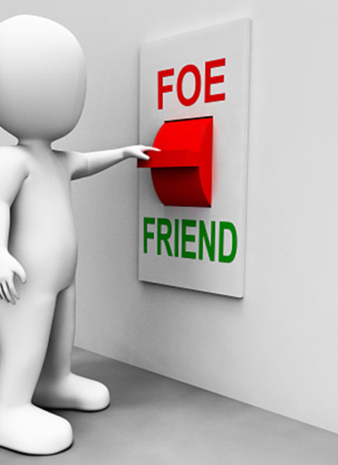
Humility
Insider/Outsider of experience
Beginners mind, curiosity and learning with others
  Limited knowledge can be garnered without lived experience
Antidote to power. Disarm the therapist as “a threat”, or “won’t get it” narrative
Therefore, draws upon client’s world and context (WICKET-BOND) which maybe similar -> very different to your understanding
Strong evidence base

Slide 49

Courage as a process

Slide 50

Rupture, Repair and Accountability
We can all get it wrong or be wronged
Some of those wrongs are historical and “in-the-world”
Ruptures and pre-ruptures (contextual) in relationship are normal
May be ‘felt’ (e.g., withdrawal) rather than explicit said “need to broach”
Work within it and listen to embodied responses (e.g., the need to be right)
Take time and understand from others perspective (what are my blinkered areas e.g., language or including WICKET-BOND) – Adult state
Accountability for your error (or part) “Sorry I contributed x” vs “Sorry you feel”
Remediate: What is required what do I/we ensure so its not repeated
May be elongated process not immediate and in time and may never

Slide 51

Relational Experience [1]: Self Care and Conscious participation
Training a laboratory to grow and challenge self but need self-care too
We have various levels of power and temperament (personal or educational harm)
Training can be challenging to enable grow e.g., feedback, assessment
Balance challenge (e.g., personal vulnerability) versus growth – contextualising needs. Is the environment “safe enough”.
Contextual understanding may be missing in relationships thus ruptures and blocking of relationships
Seek help if participation blocked or feel harmed: tutors, therapy, supervision, peers, affinity groups, BAATN, PinkTherapy, SPOKZ People

Slide 52

Relational Experience [2]: Support and Allyship
Notice your standpoint in group dynamics, in conflict, and what may be fair/unfair
Types of discernment to be involved
  Bystander: don’t get involved. May take-in or ignore.
  Active Bystander / Acceptance: Through thoughtful appraisal
  Empathic support
  All and both sides – Mediator (Facilitator)
  Allyship / Advocate – Is it a lack of contextual positioning?
  Reflect on gain/loss in allyship and interventions

Slide 53
Exercise
Clarify understanding of Rupture, Repair and Accountability
Self care and participation – barriers and opportunities
Stance on support and allyship

Slide 54
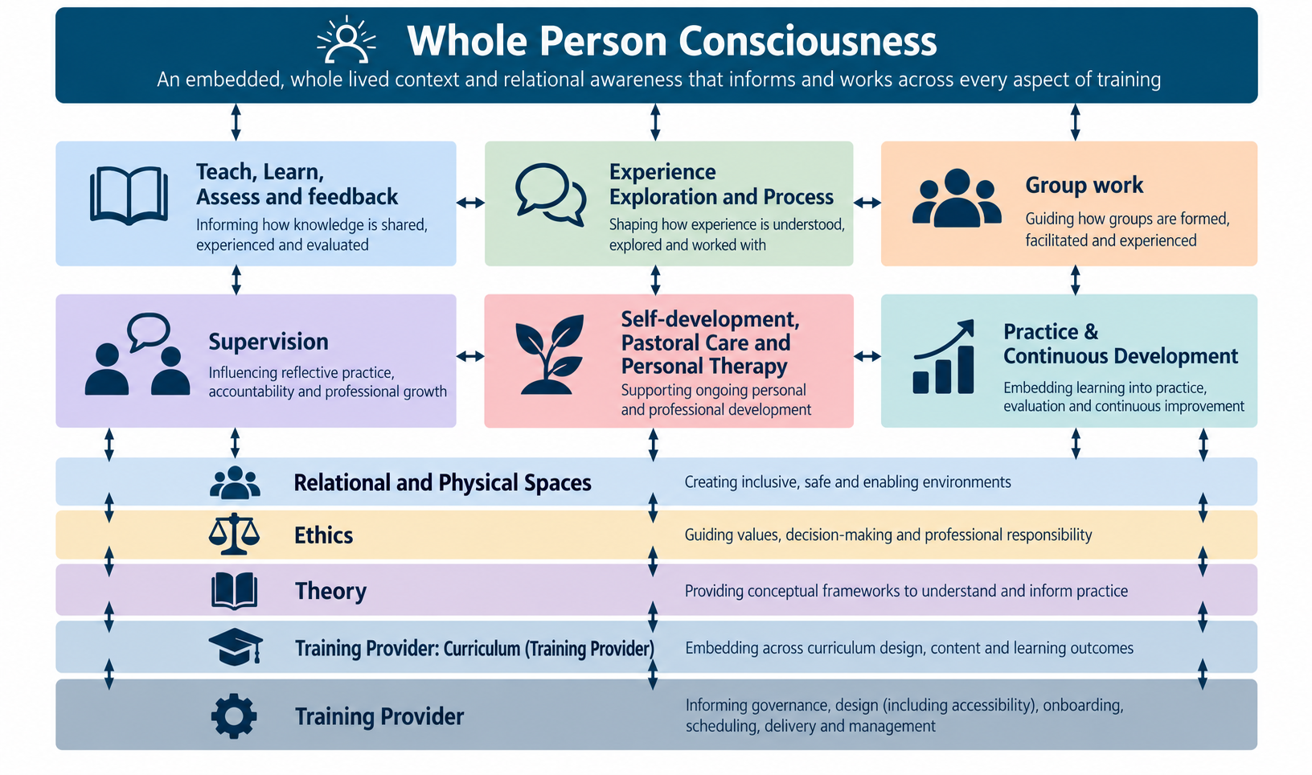

Slide 55
Applications
Understanding relationships and lived experience
Case studies and Essay topics
Your positionality
Building relationships and understanding context of ruptures
Further learning in peers and group processes
Further models: Whole conceptualisation and Whole Organisation

Slide 56
Exercise
What do you take from today?
What is your edge of further self-development

Slide 57

Summary and next steps
Embed the whole experience and relational model
Continuous reference point for all subjects – What if scenarios
Tell others adopt and advocate…
Additional resources: tadf.co.uk
Email: admin@tadf.co.uk for additional support
Good luck with your studies!

Slide 58
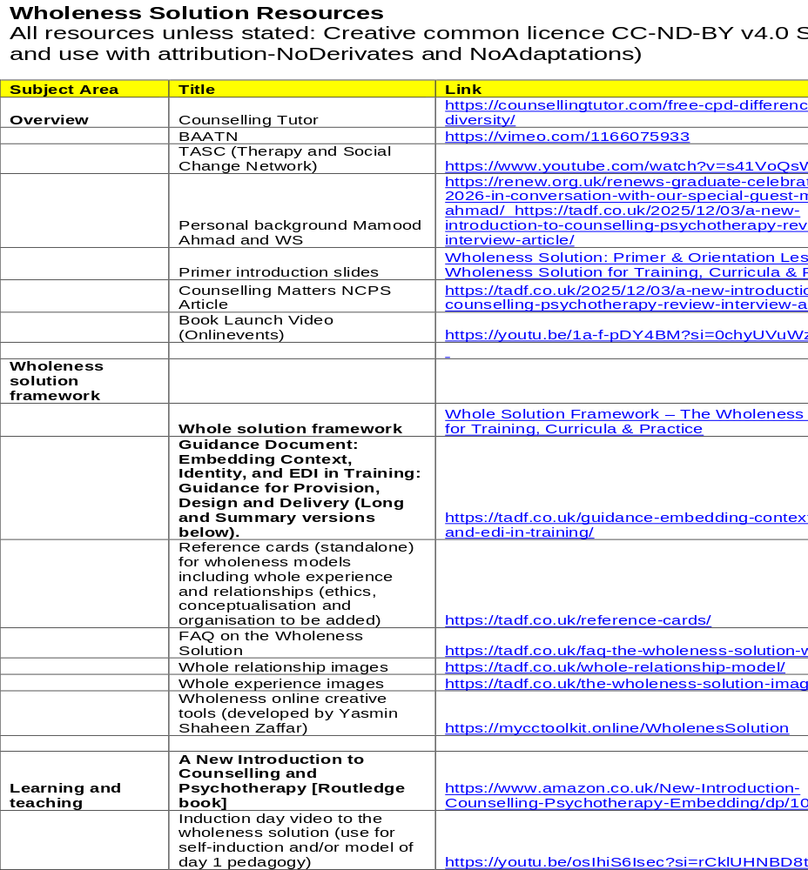
Resources
Support
Learner resources
WS Framework
Train the trainer resources
  Embedding in Training (Self Assessment Guidance)
Supervision

